Slide 1
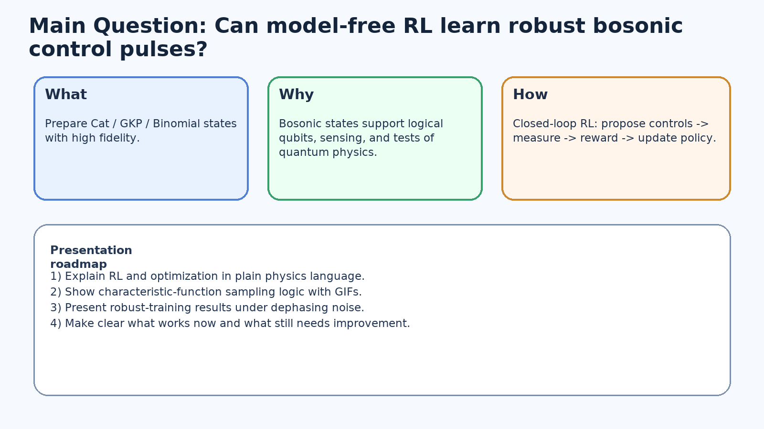
Trapped-Ion Bosonic State Preparation via Model-Free Reinforcement Learning
Motivation, method, and dephasing-robust training results
Core question: can RL learn high-fidelity and noise-robust pulses from measurement feedback?
Targets: Cat, GKP, and Binomial bosonic states.
Today: explain RL loop clearly, then show visual evidence and robust-training outcomes.
The presentation focuses on physical interpretation of the optimization workflow.
Main structure: Motivation -> Setup/Method -> RL optimization loop -> Results -> Outlook.
Project overview
1

Slide 2
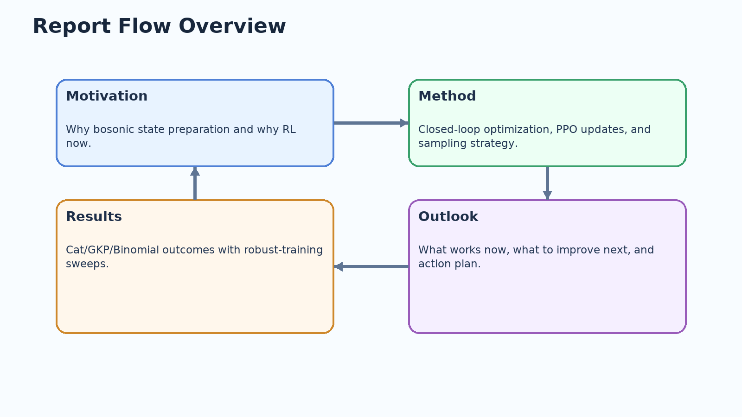
Agenda
1) Why bosonic state preparation matters (logical qubits, sensing, fundamental physics).
2) What model-free RL is doing in this project and why this is interesting.
3) How optimization works: control parameters -> quantum feedback -> policy update loop.
4) Characteristic-function reward and how sampling points are selected over training.
5) Results for Cat, GKP, and Binomial states (images + GIFs).
6) Dephasing-robust training: quasi-static and stochastic penalty sweeps.
7) Conclusions, open issues, and immediate next steps.
Report structure
2

Slide 3
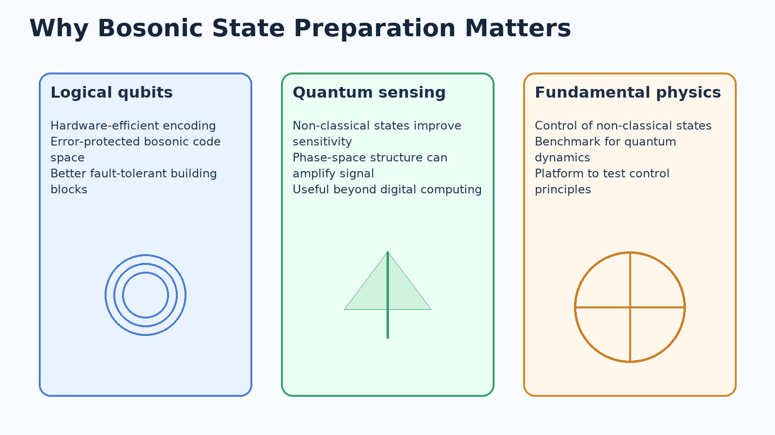
Why This Problem Matters
Preparing non-classical bosonic states is a foundational control task.
Better state preparation supports encoded qubits and practical logical operations.
The same control ideas are relevant for sensing and broader quantum-state engineering.
If we can automate pulse search with RL, we can scale exploration faster than manual tuning.
Motivation links directly to encoded bosonic qubits, sensing relevance, and control of non-classical dynamics.
Motivation
3

Slide 4
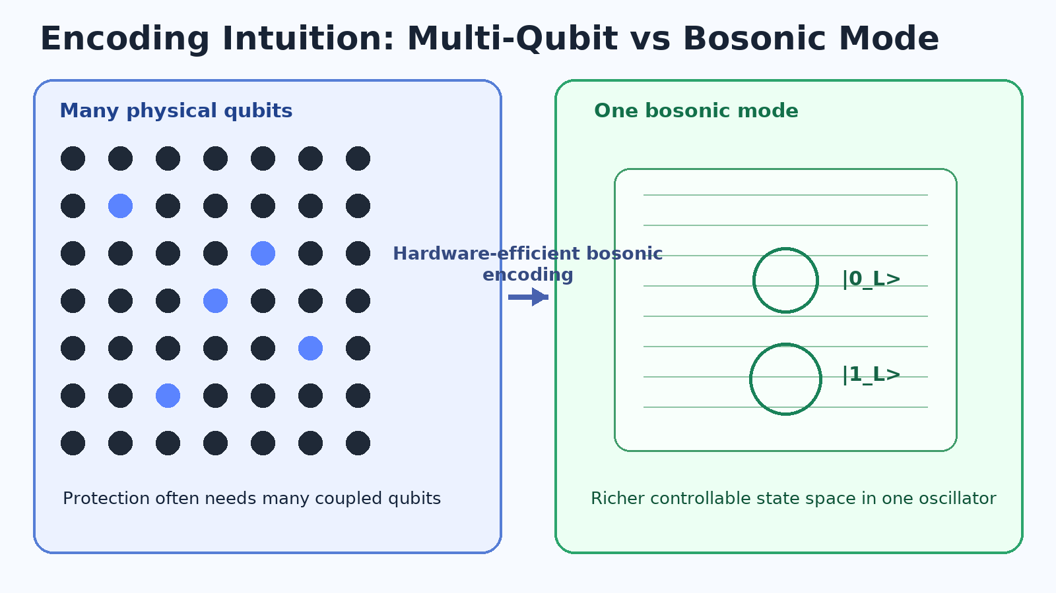
Bosonic Encoding Intuition
Conventional route: many physical qubits are combined for protection.
Bosonic route: one oscillator mode provides a richer controllable state space.
This project focuses on preparing bosonic target states with high accuracy and stability.
Motivation organization follows Sivak (RL control) and bosonic-code context from group discussions.
This motivates focusing on pulse optimization for bosonic target-state preparation.
Conceptual setup
4

Slide 5
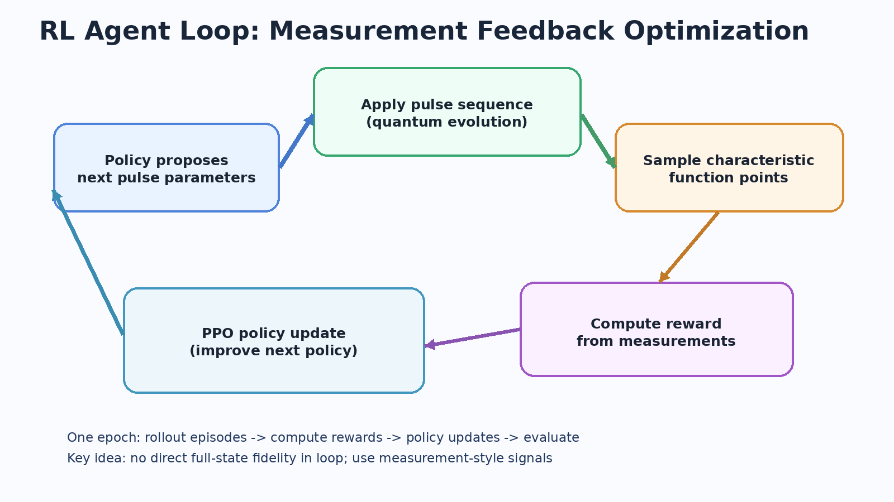
Why Model-Free RL Here?
We want an optimizer that can learn directly from measured feedback signals.
Model-free RL does not require an analytic gradient of the full physical system.
The policy can iteratively improve by comparing outcomes from many trajectories.
This is a natural fit for closed-loop control where reward is computed from observables.
In short: RL acts as an adaptive pulse-search strategy under realistic feedback constraints.
Method motivation
5

Slide 6
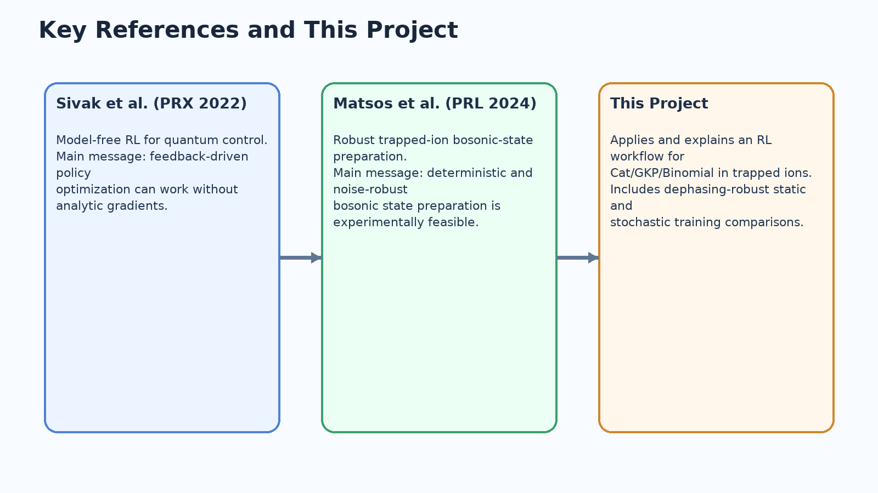
Related Works and Positioning
Sivak et al. (PRX 2022): model-free RL can optimize quantum control directly from feedback.
Matsos et al. (PRL 2024): robust and deterministic trapped-ion bosonic-state preparation was demonstrated experimentally.
This project: apply and explain an RL workflow for trapped-ion Cat/GKP/Binomial preparation,
including dephasing-robust static and stochastic training branches.
Context and contribution
6

Slide 7
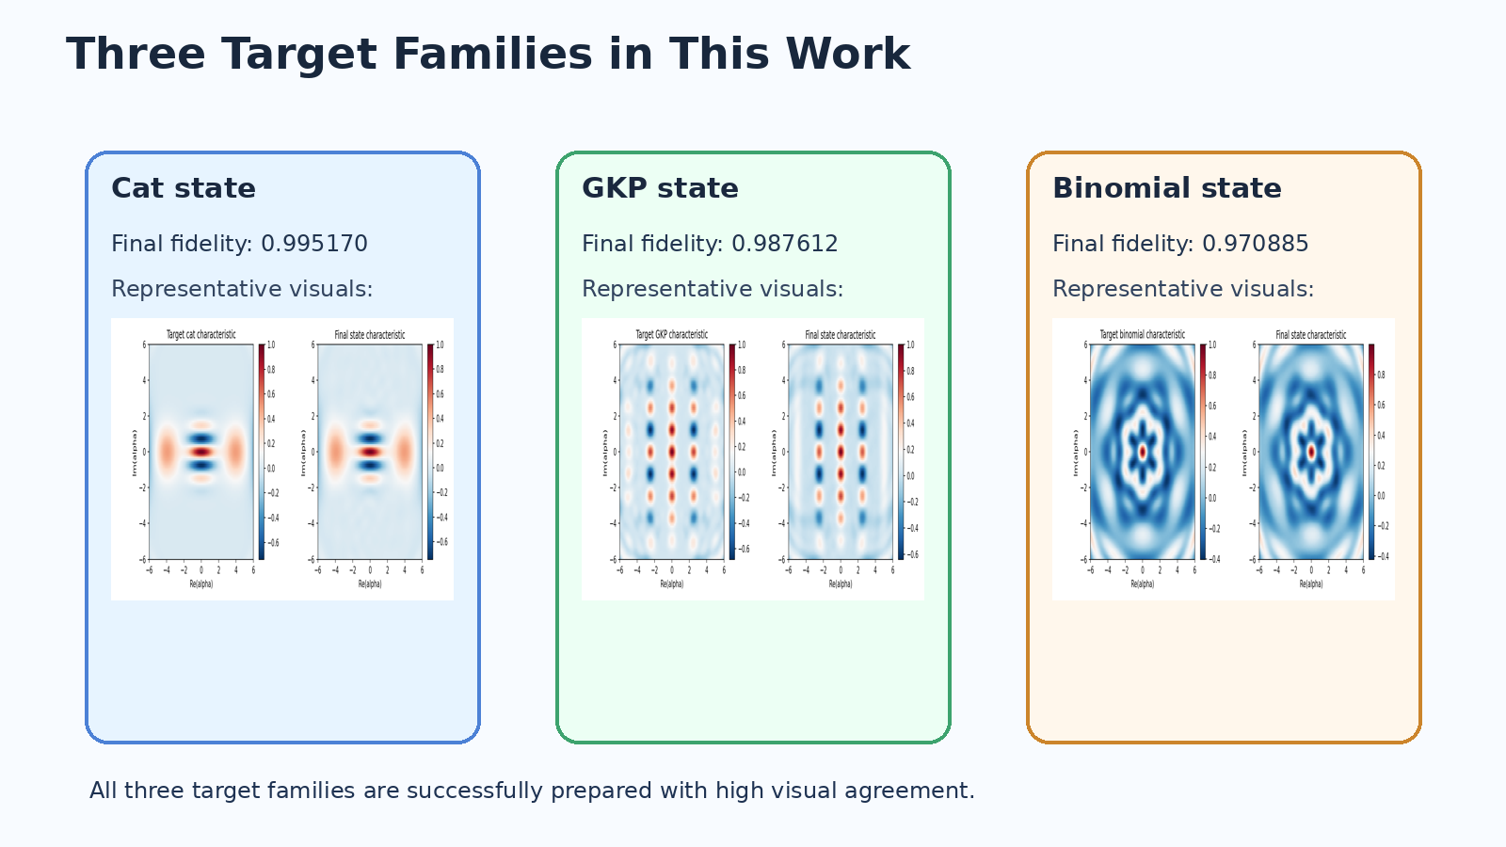
Project Scope in One Slide
State families covered: Cat, GKP, and Binomial.
Optimization style: model-free RL with PPO policy updates.
Reward style: characteristic-function agreement, not full-state tomography in loop.
Robustness: dephasing-aware training with quasi-static and stochastic noise branches.
Compute path: dynamiqs/JAX simulation with GPU acceleration and parallel rollout strategy.
Project scope
7

Slide 8
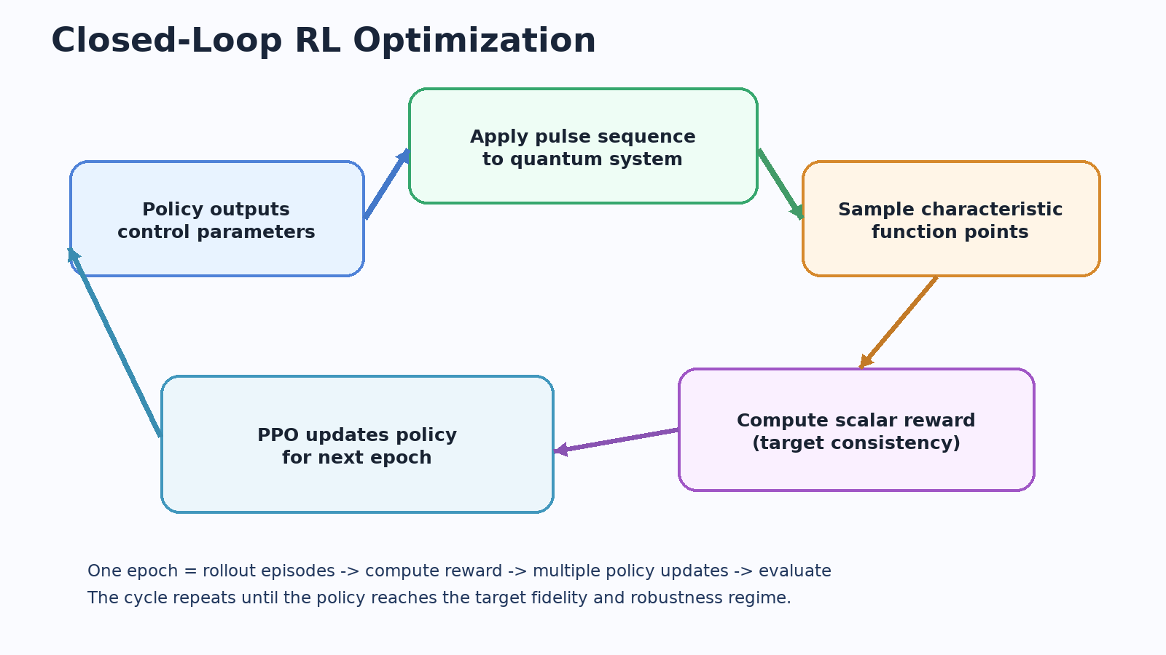
How the RL Control Loop Works
The policy proposes pulse parameters for each trajectory.
The simulator executes the pulse sequence and returns trajectory-level measurement reward.
Reward is derived from characteristic-function mismatch at sampled points.
PPO applies repeated policy updates, then the improved policy generates the next epoch.
This is an iterative policy-improvement loop under measurement-style feedback.
Loop interpretation: the control policy is updated from rollout returns, not from analytical gradients of the physics model.
Optimization loop
8

Slide 9
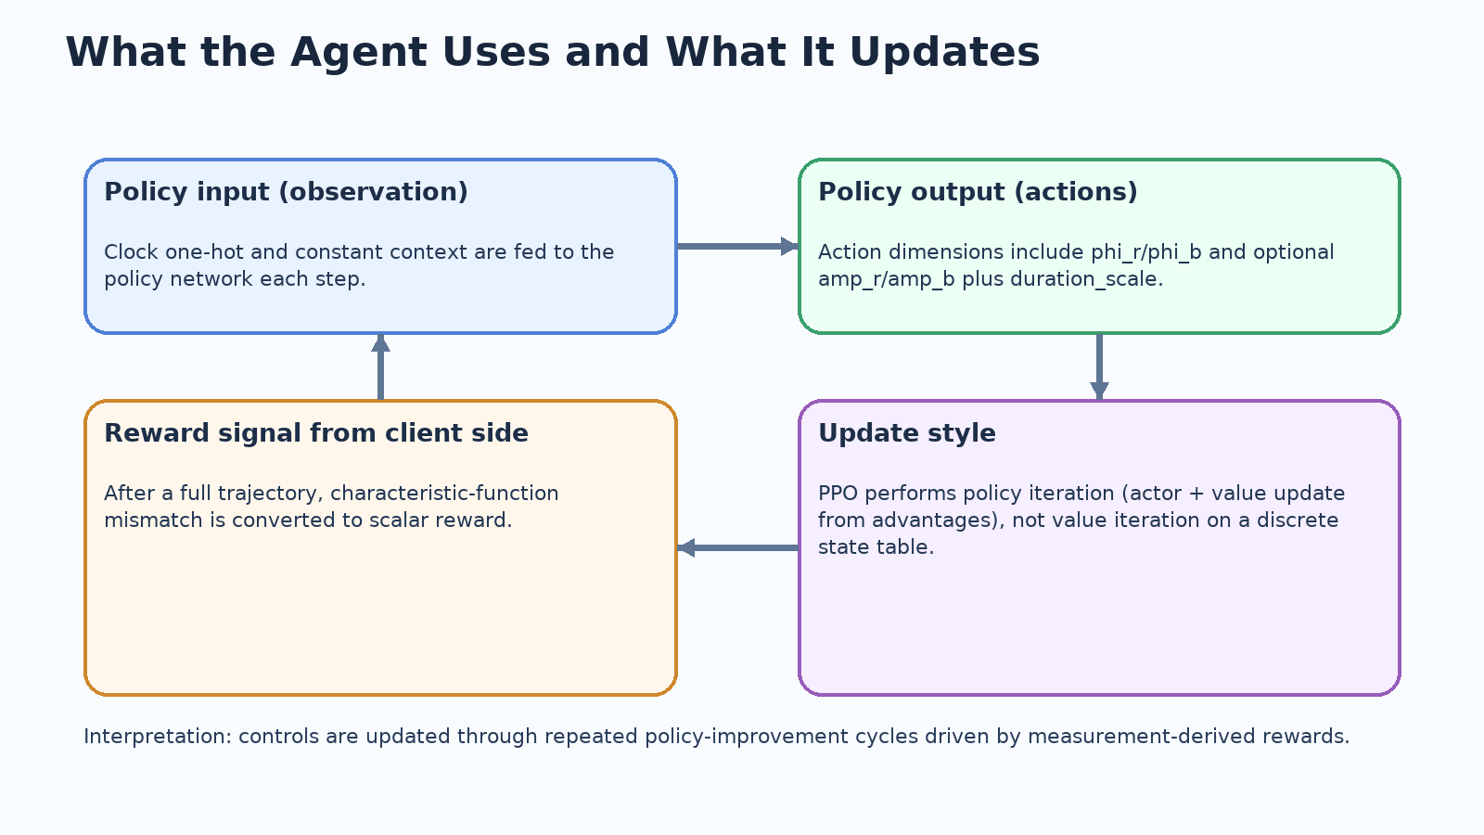
Agent Inputs, Outputs, and Update Type
Policy input: clock/step context and constant channel from the environment interface.
Policy output: segmented pulse parameters (phi_r, phi_b, optional amplitudes, duration_scale).
Client computes reward after full trajectory execution and sends scalar returns.
Update type: policy iteration (actor + value update via PPO), not tabular value iteration.
This distinction matters when explaining why PPO is used in this continuous-control setting.
What is optimized each epoch
9

Slide 10
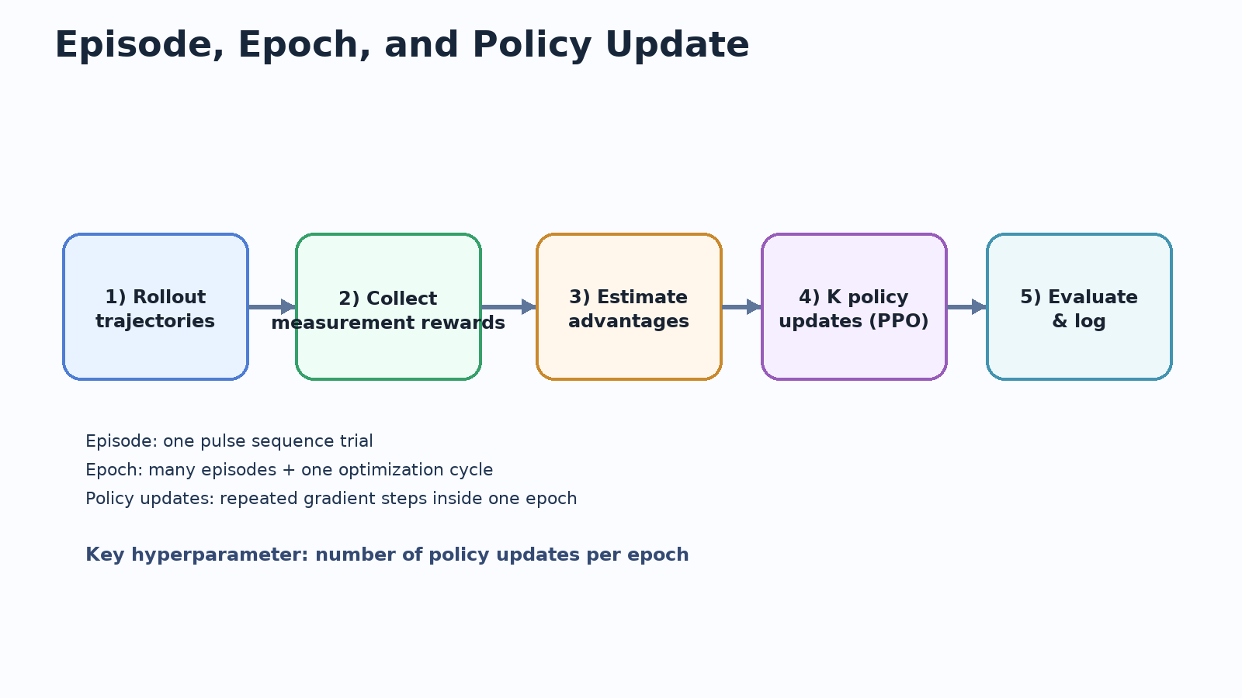
Episode, Epoch, Policy Update
Training workflow
10

Slide 11
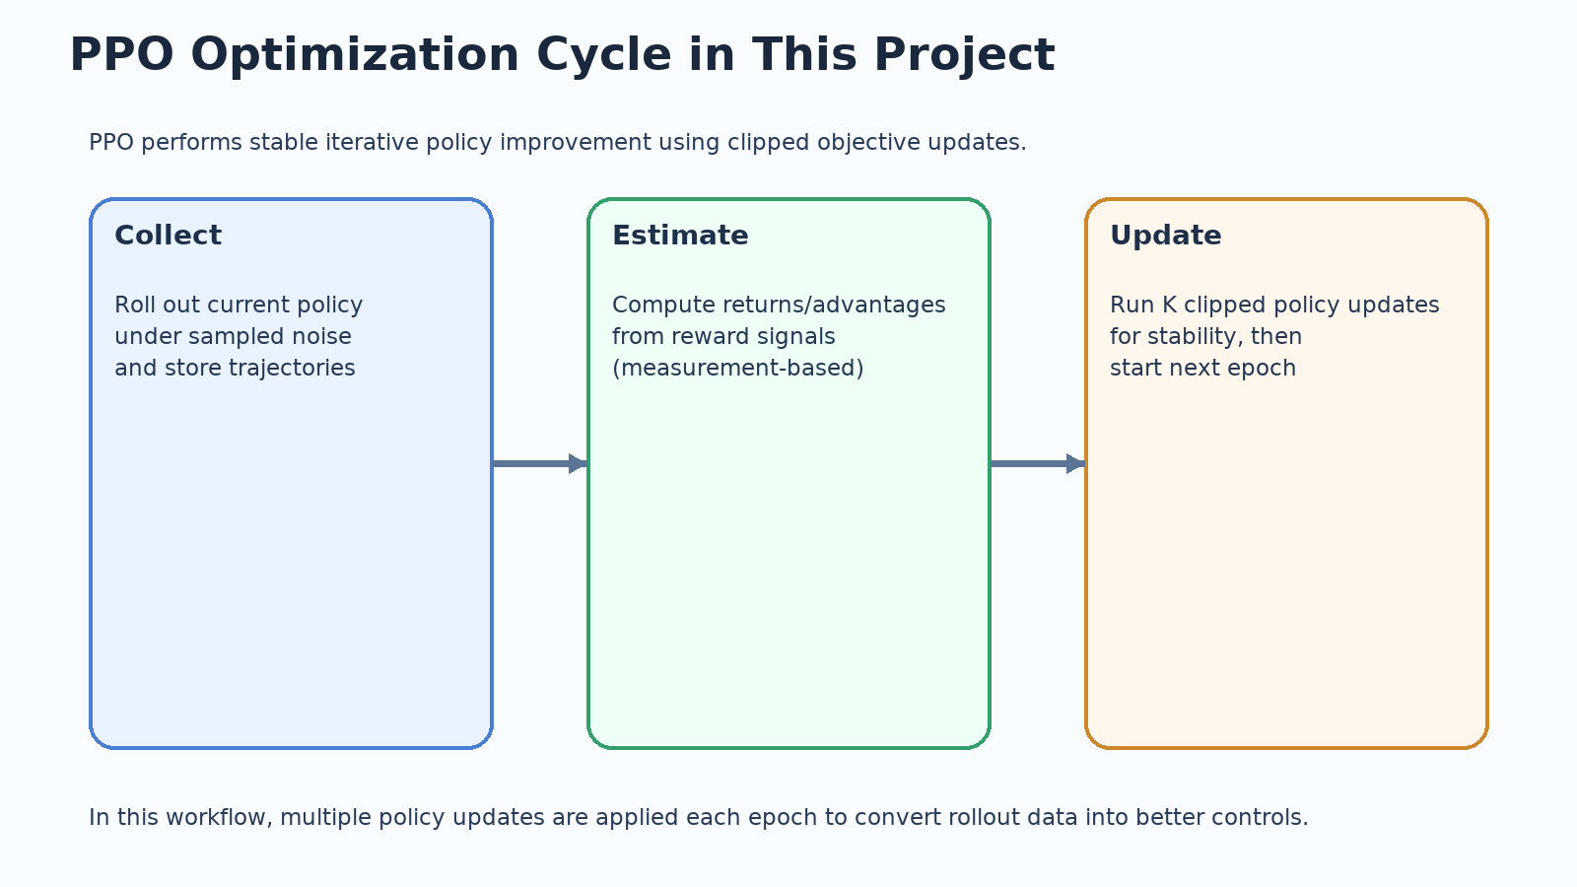
Proximal Policy Optimization (PPO)
PPO is an on-policy actor-critic method for stable policy iteration.
Each epoch: collect trajectories -> compute advantages with value network -> update actor and critic.
Clipped policy objective constrains update size and prevents destructive policy jumps.
In this project, policy-update count per epoch is a high-impact hyperparameter.
We therefore report policy-update settings explicitly for Cat, GKP, and Binomial targets.
Policy optimization method
11

Slide 12
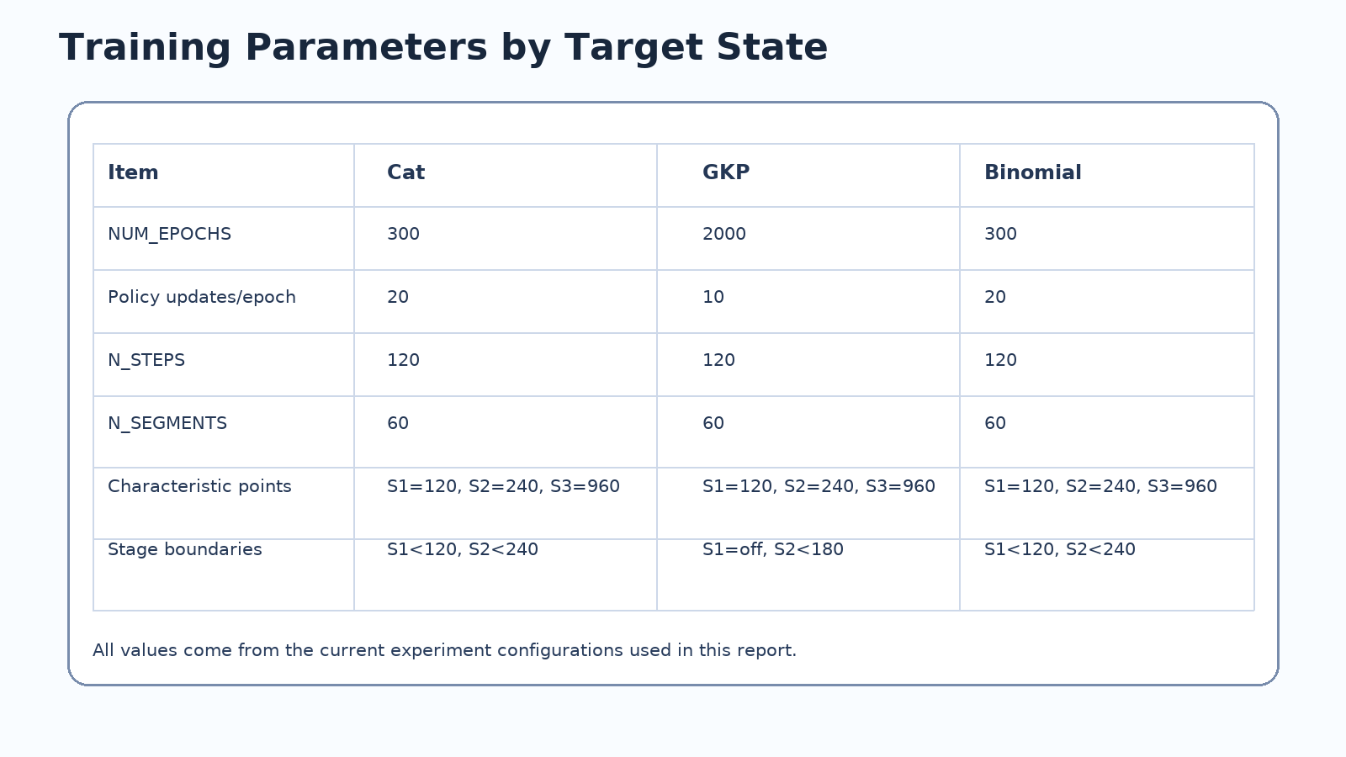
Why Different States Need Different Hyperparameters
Different target geometries create different optimization difficulty.
GKP needs longer training budget due to lattice-like structure constraints.
Binomial uses stage-wise characteristic sampling to improve stability.
Policy-update count and epoch budget matter more than minor entropy tuning here.
State-dependent optimization behavior
12

Slide 13
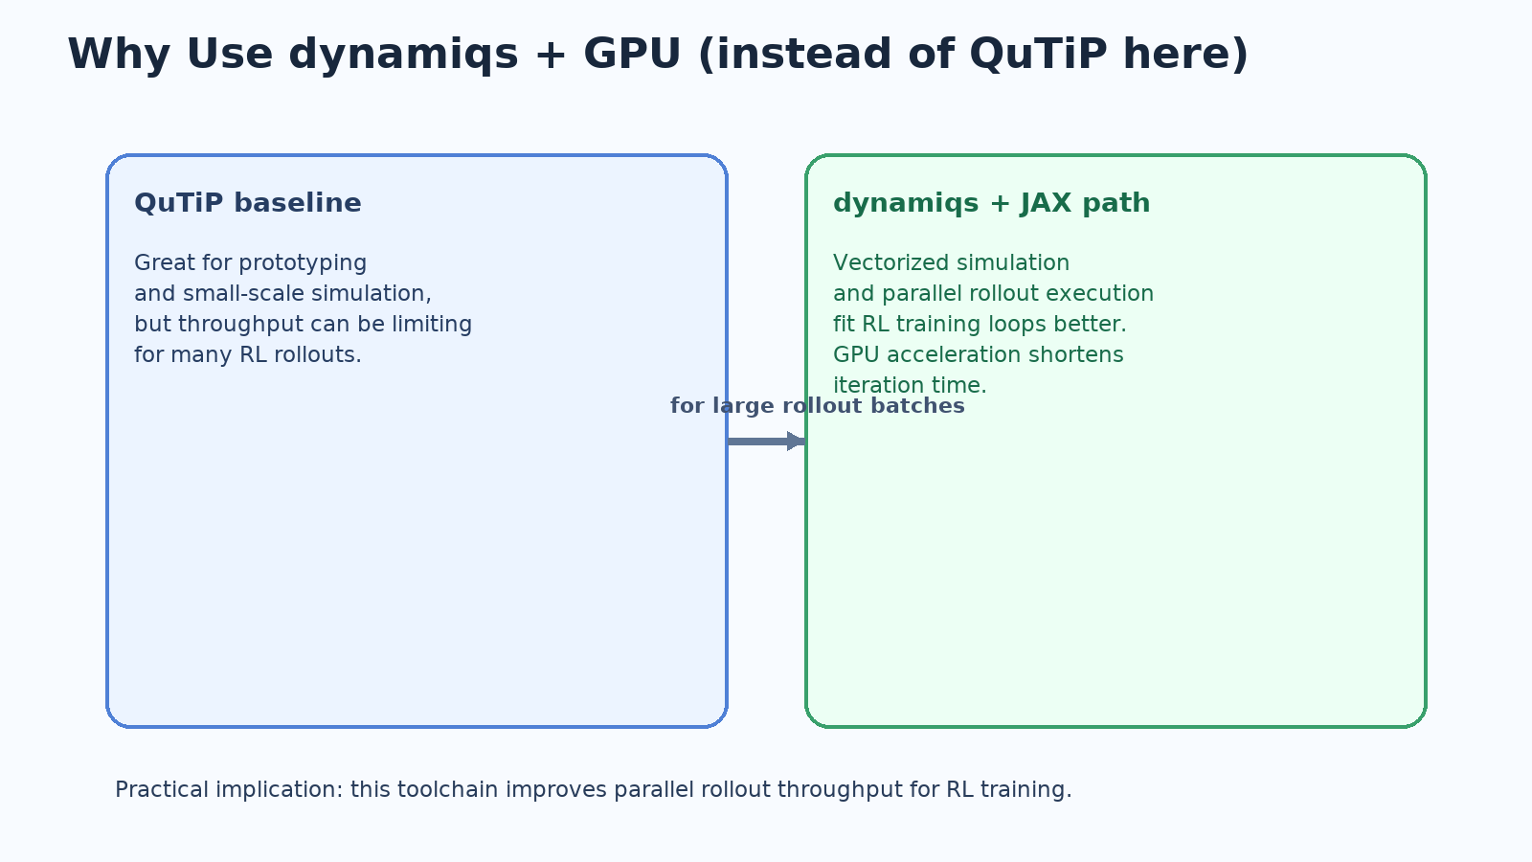
dynamiqs vs QuTiP and GPU Use
Main reason for dynamiqs path: better parallel rollout throughput.
RL training repeatedly evaluates many trajectories, so batching matters.
GPU acceleration reduces wall-clock cost for iterative optimization.
Presentation-level message: this improves training practicality, not just implementation detail.
Simulation platform choice
13

Slide 14
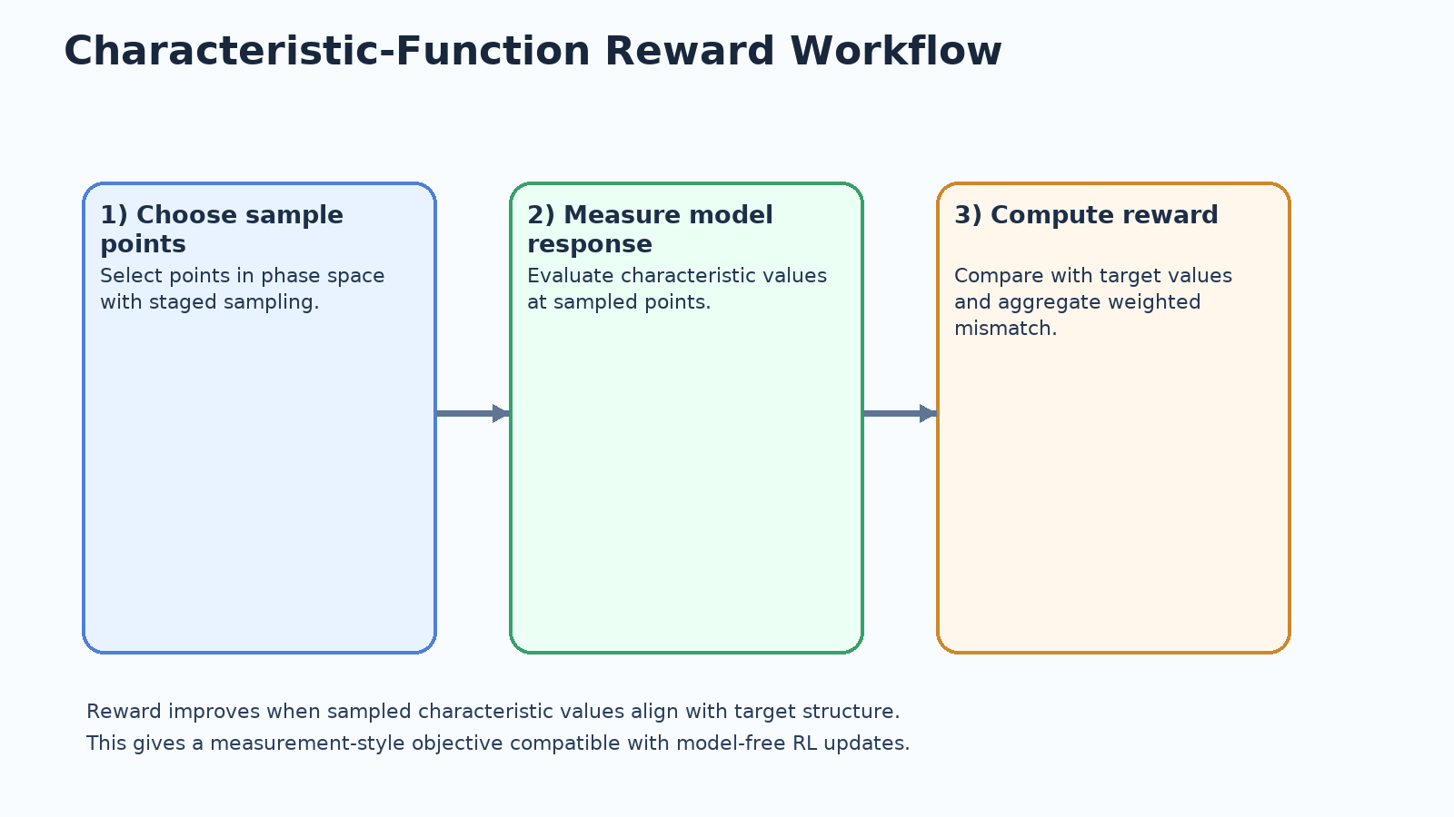
Characteristic-Function Reward
Reward is computed from sampled characteristic-function points.
This acts like measurement-style feedback and avoids relying on full state information inside the loop.
It also provides visual diagnostics: target vs final characteristic maps are easy to compare.
This is where the RL loop connects directly to physics observables.
Reward definition
14

Slide 15
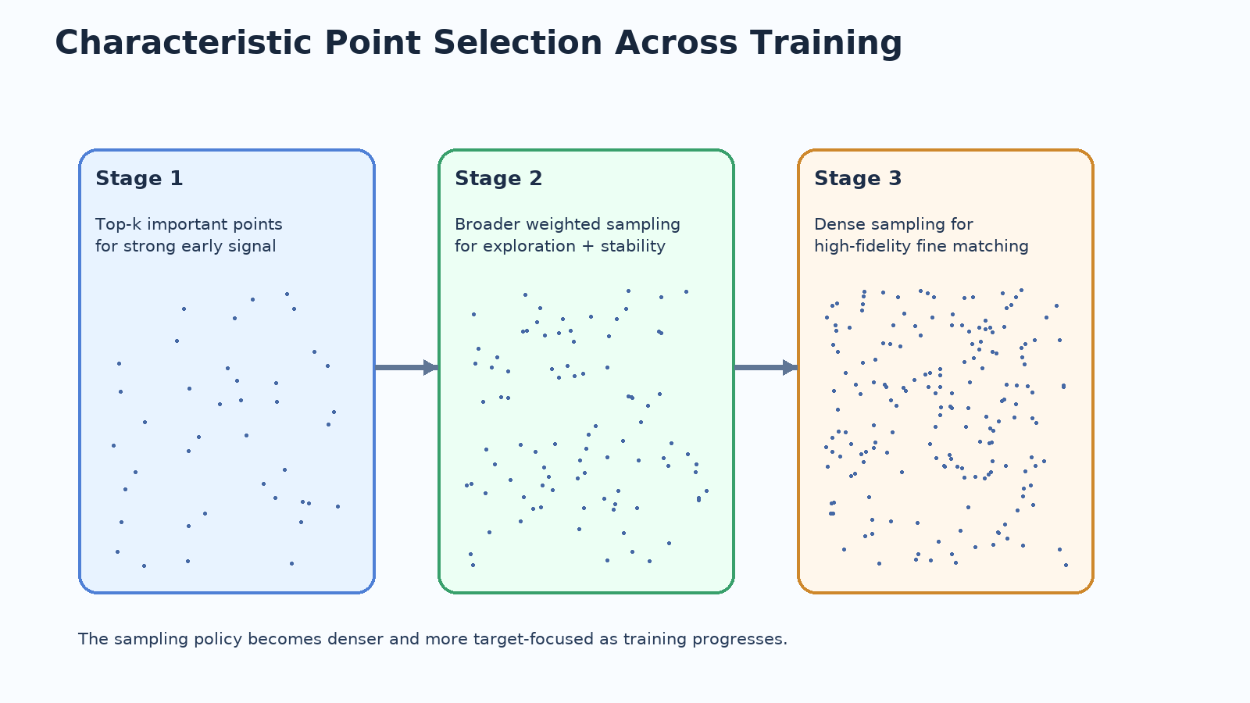
Training Signal Scheduling
Stage 1 uses a focused subset to provide strong initial learning signal.
Stage 2 expands sampled coverage to improve stability and exploration.
Stage 3 uses denser sampling for final high-fidelity refinement.
This schedule is applied consistently across training epochs.
Point-evolution GIFs are shown later in the results section.
Stage-wise training setup
15

Slide 16
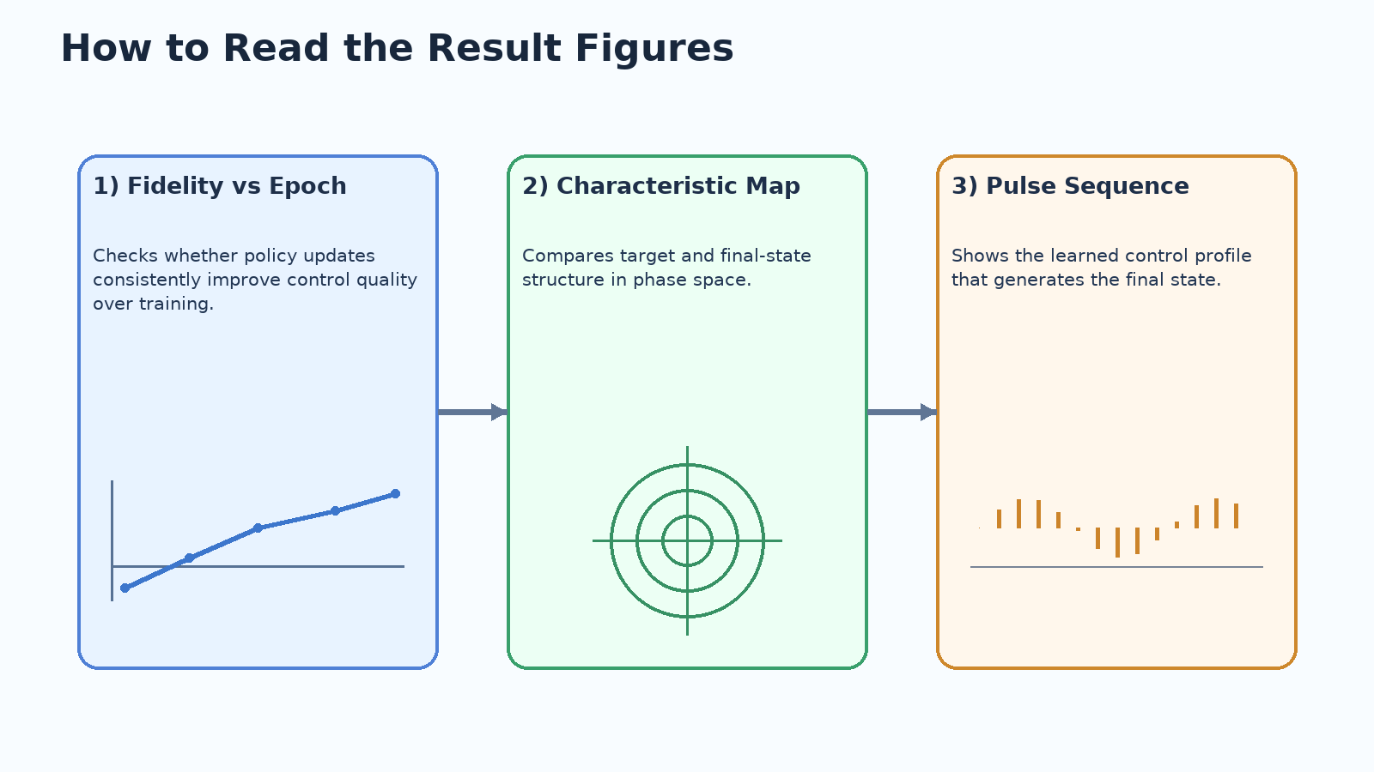
How to Read Training Outputs
Training curves show whether policy updates are producing consistent improvement.
Characteristic maps show structural agreement between target and final state.
Pulse panels show the learned control structure used to produce the final state.
Dephasing comparison curves show robustness tradeoff under detuning noise.
Together these plots provide a complete per-state result summary.
These figure types are used in the next slides to tell the Cat/GKP/Binomial story consistently.
Interpreting result figures
16

Slide 17
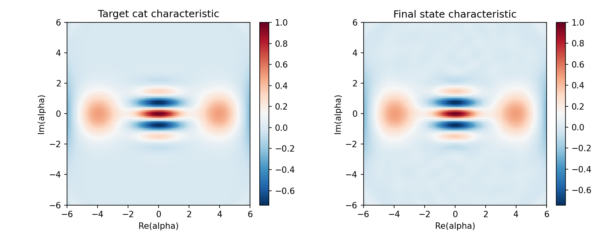
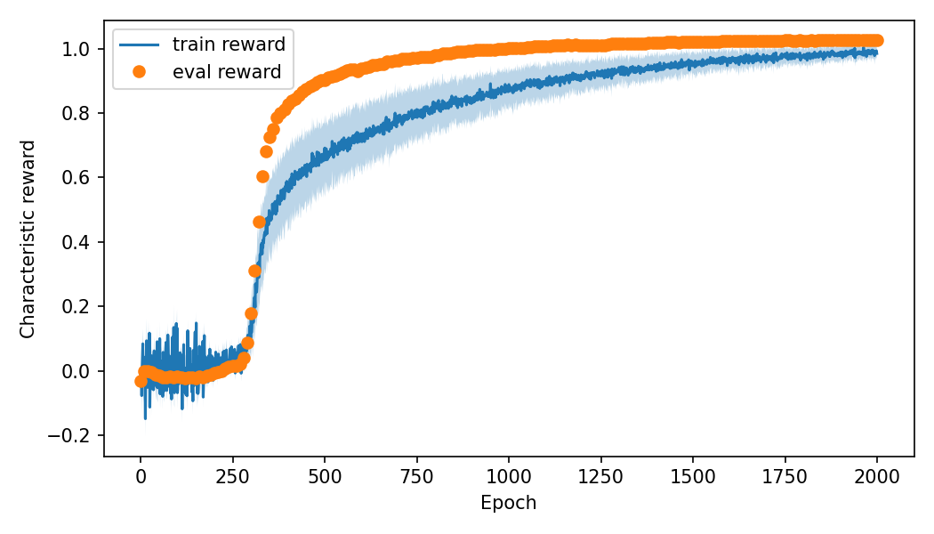
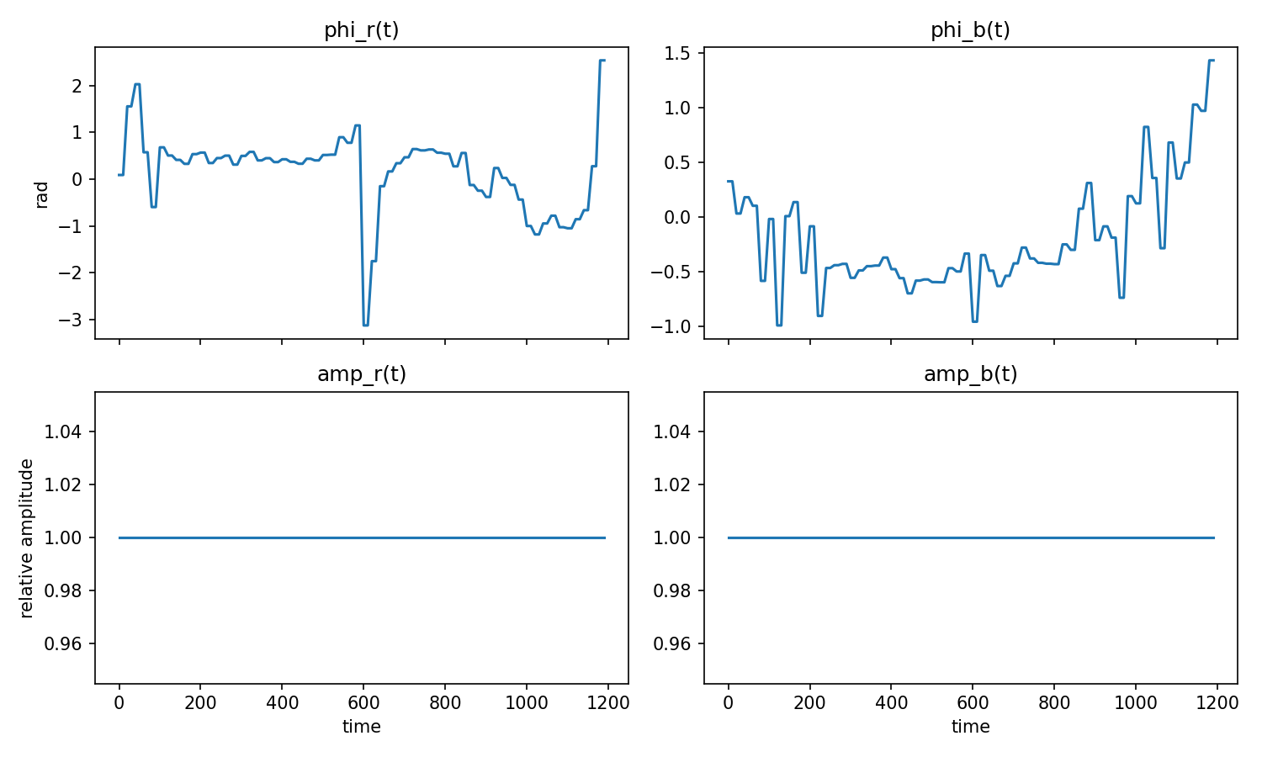
Cat State Results
Final cat fidelity: 0.995170
Left: target vs final characteristic map | Middle: fidelity trend | Right: learned pulse structure
Cat target
17

Slide 18
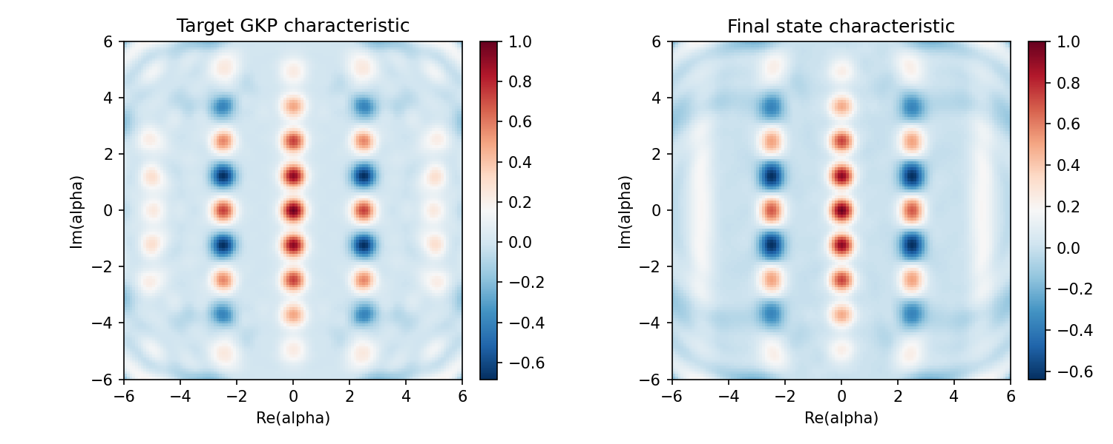
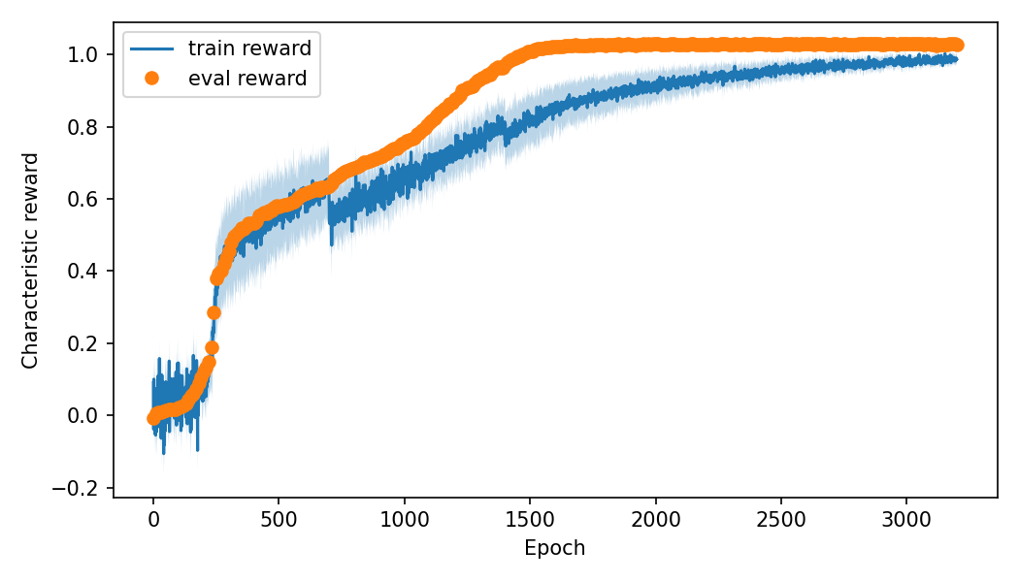
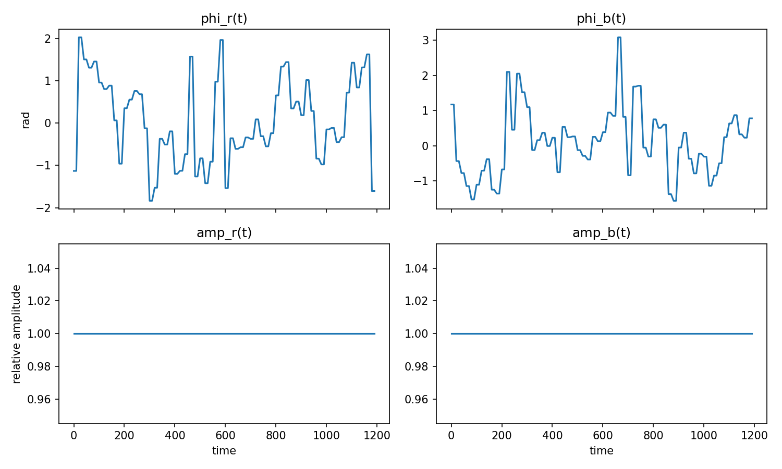
GKP State Results
Final GKP fidelity: 0.987612
GKP requires stronger structural matching, which motivates larger epoch budget.
GKP target
18

Slide 19
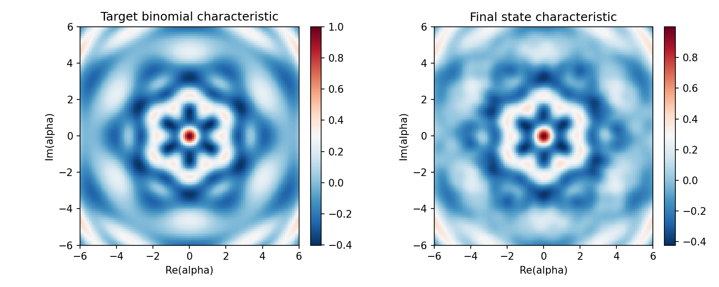
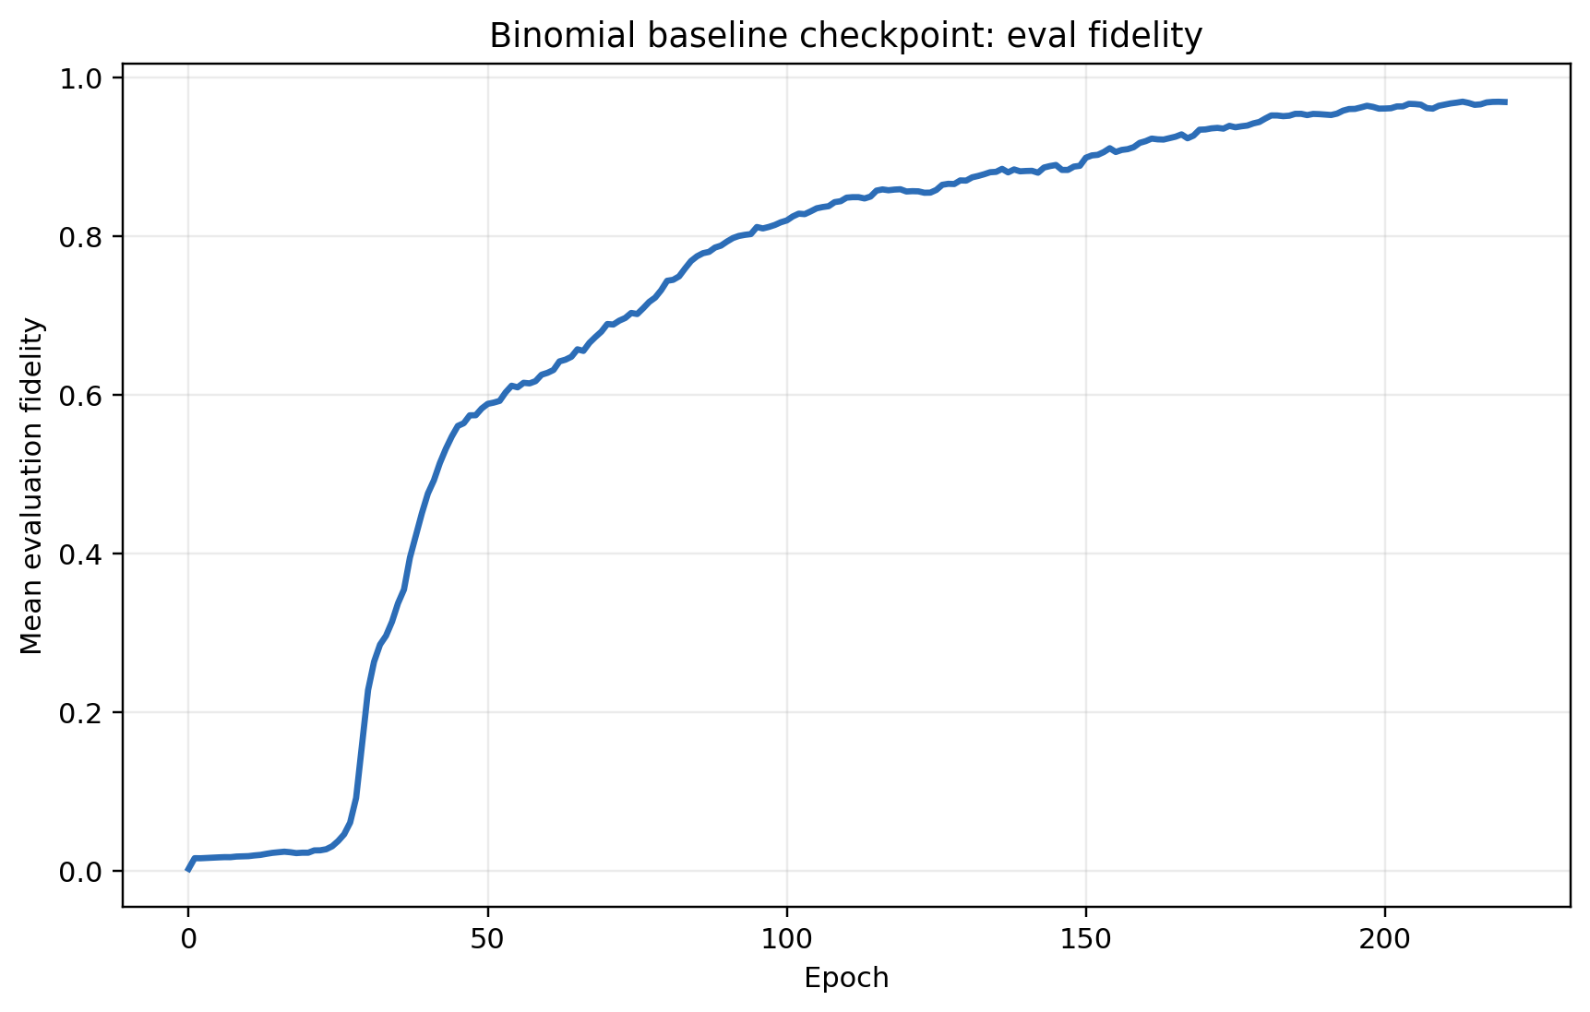
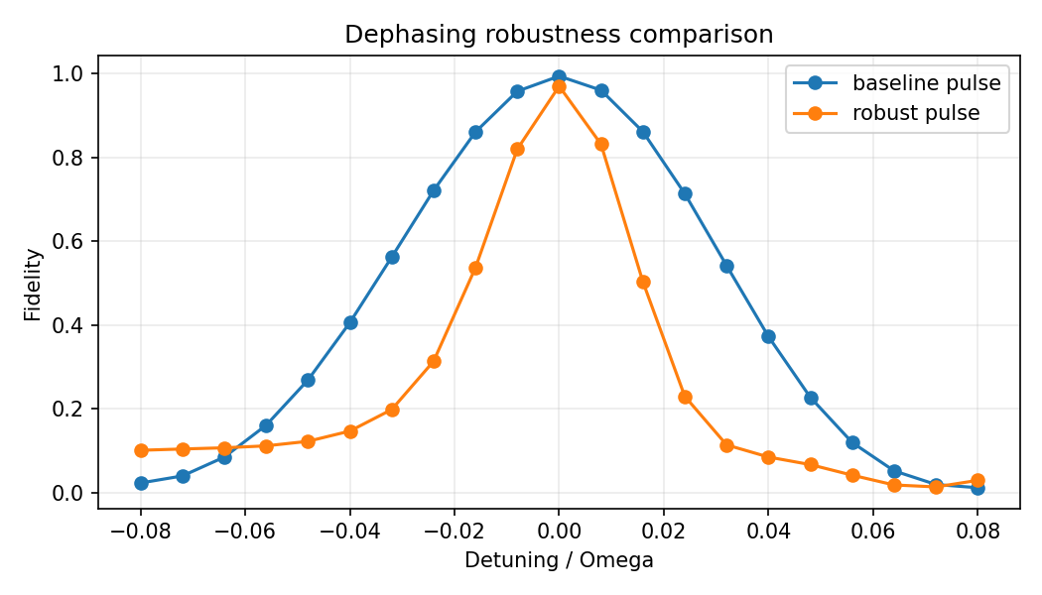
Binomial Baseline Result (Before Robust Extension)
Baseline checkpoint fidelity: 0.970683 | score: 0.807031 | robust fidelity under sweep: 0.821348.
This baseline motivated the dephasing-robust branch and the subsequent penalty sweeps.
Left: target vs final map | Middle: baseline evaluation trend | Right: baseline dephasing response
Binomial nominal checkpoint
19

Slide 20
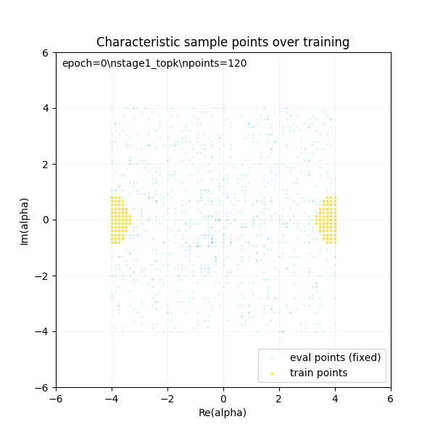
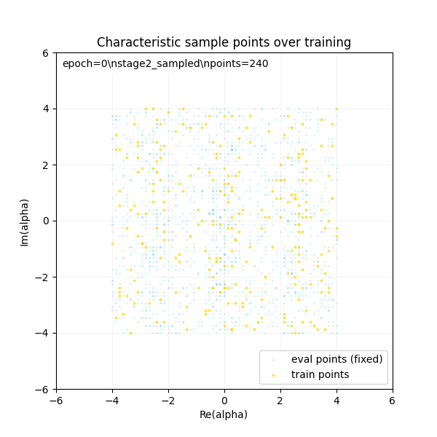
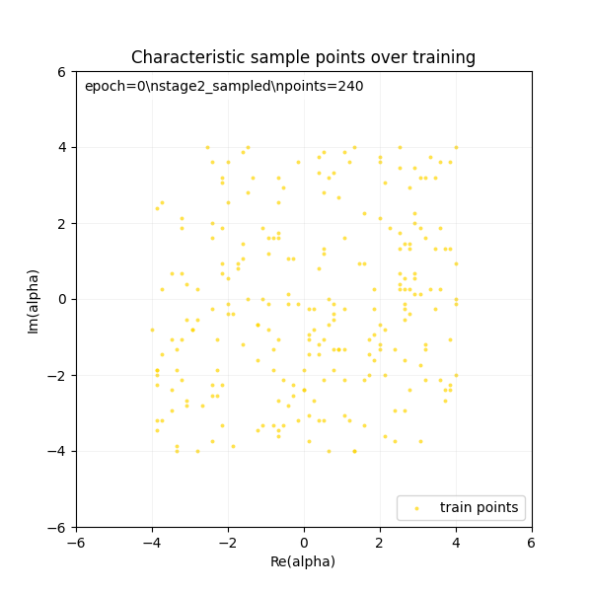
Characteristic-Point Evolution (GIFs)
All targets show staged movement from broad exploration toward informative phase-space regions.
Cat GKP Binomial
Sampling-point evolution across targets
20

Slide 21
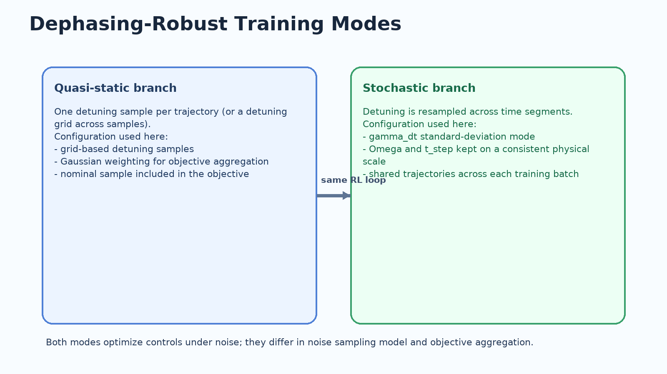
Robust-Training Configuration
Quasi-static branch: grid detuning samples + gaussian weighting.
Stochastic branch: segment-wise random detuning with gamma_dt scale.
Physical scale alignment enforced: Omega_r=Omega_b=2π×2000 Hz and T_STEP=1e-5 s.
Scale consistency rule: if Omega changes by factor k, T_STEP should change by 1/k.
Duration scaling action is enabled to let optimizer adapt effective pulse duration.
Dephasing-robust setup
21

Slide 22
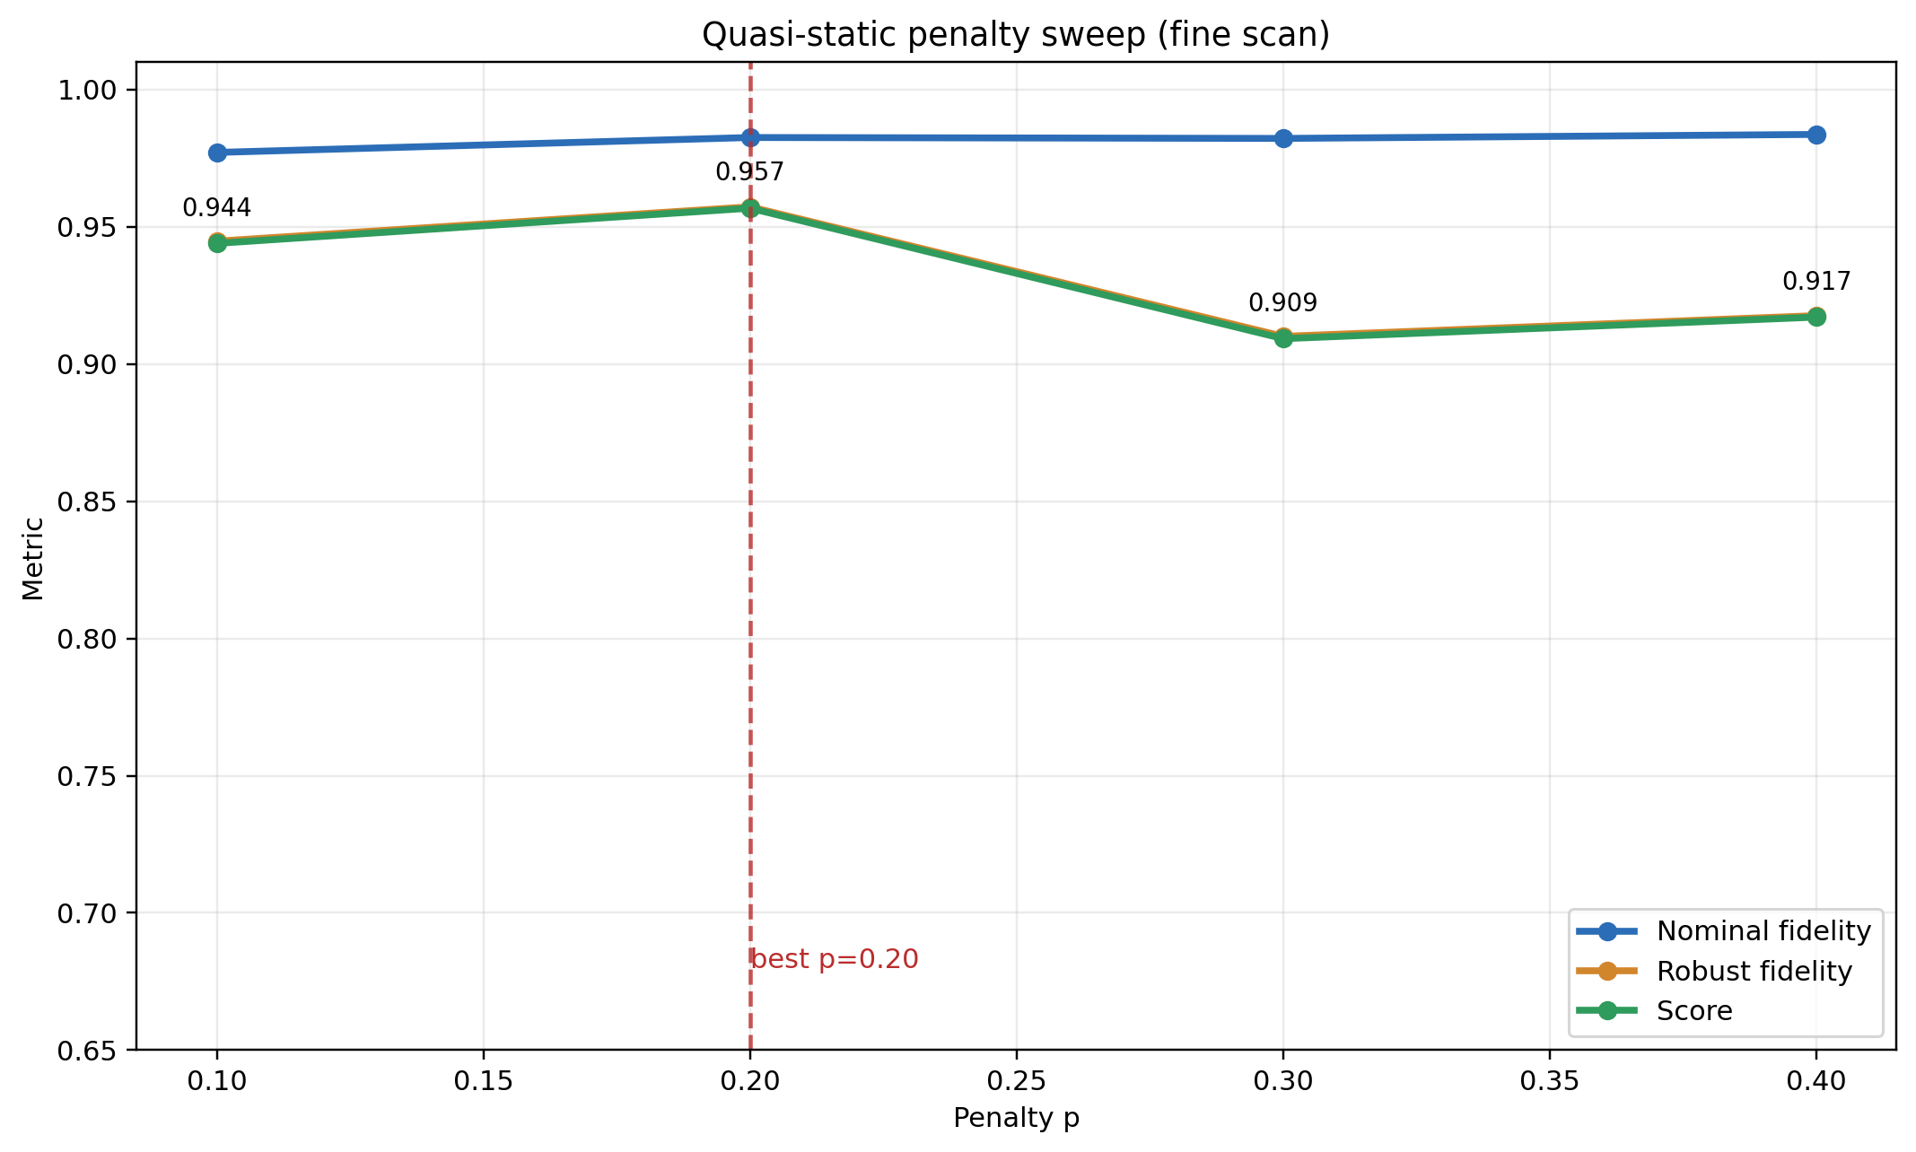
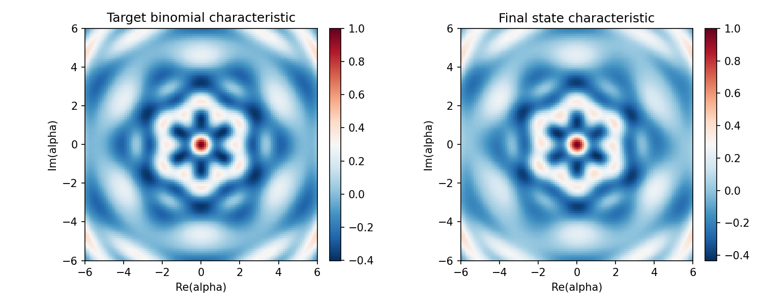
Quasi-Static Penalty Sweep (Fine Scan)
Best quasi-static score occurs at p=0.20.
At p=0.20: score=0.956800, f_nom=0.982545, f_rob=0.957291.
This branch currently achieves stronger robust-fidelity average than the stochastic branch.
Mean gain over baseline in dephasing sweep: 0.467.
Static best improves average dephasing robustness while keeping high nominal fidelity.
Points: p=0.1, 0.2, 0.3, 0.4
22

Slide 23
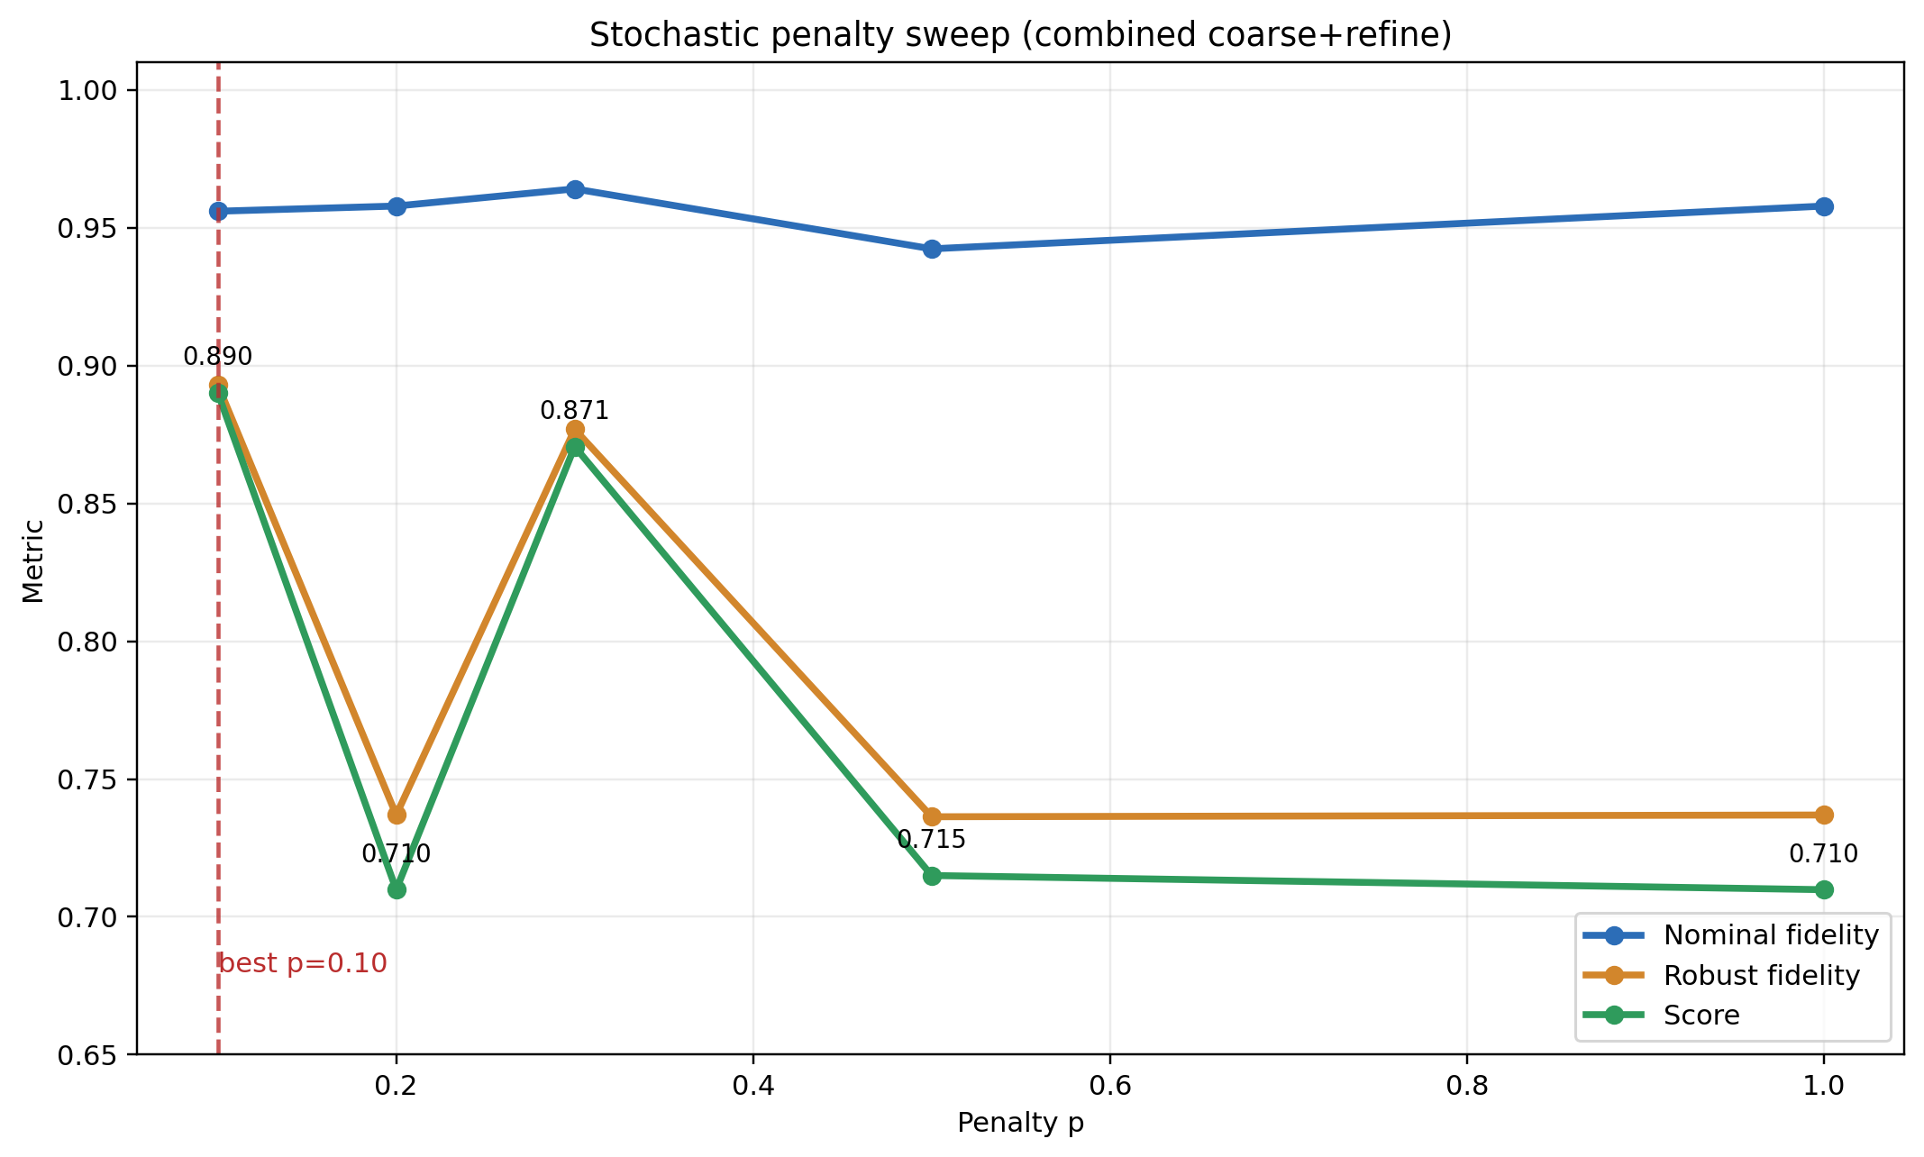
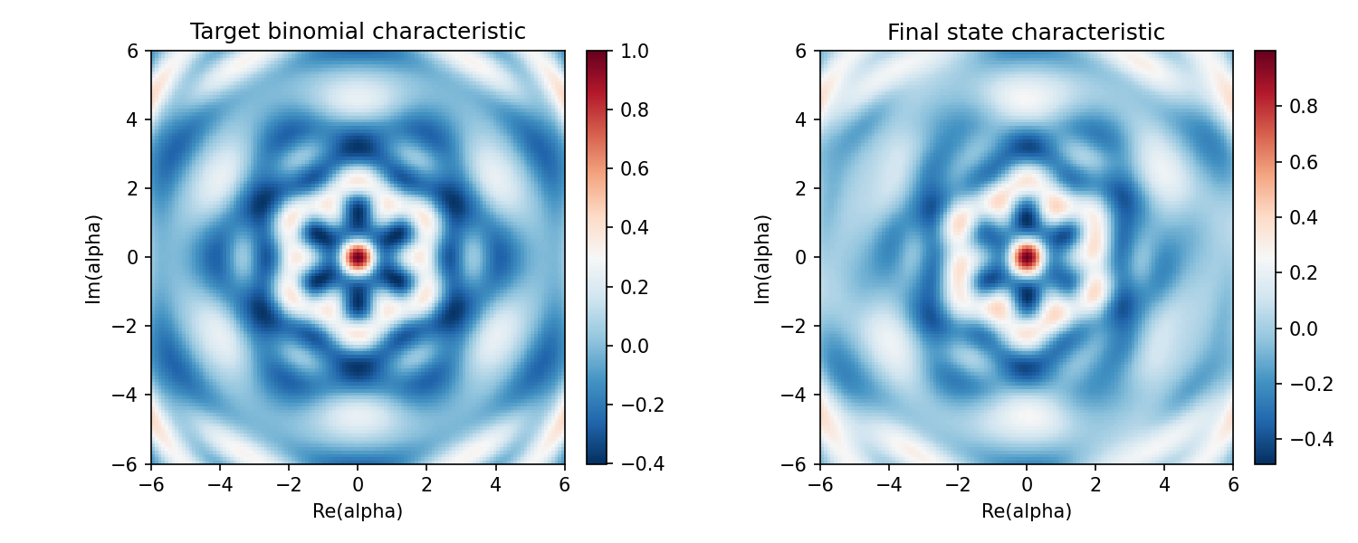
Stochastic Penalty Sweep (Combined)
Best stochastic score in current runs is at p=0.10.
At p=0.10: score=0.890209, f_nom=0.956010, f_rob=0.893108.
Stochastic branch is improving but still behind best quasi-static robust average.
Result suggests noise-model complexity currently needs more tuning/compute budget.
Stochastic best currently trails static best but remains a valid path for realistic random-noise training.
Combined points include p=0.1/0.2/0.3/0.5/1.0
23

Slide 24
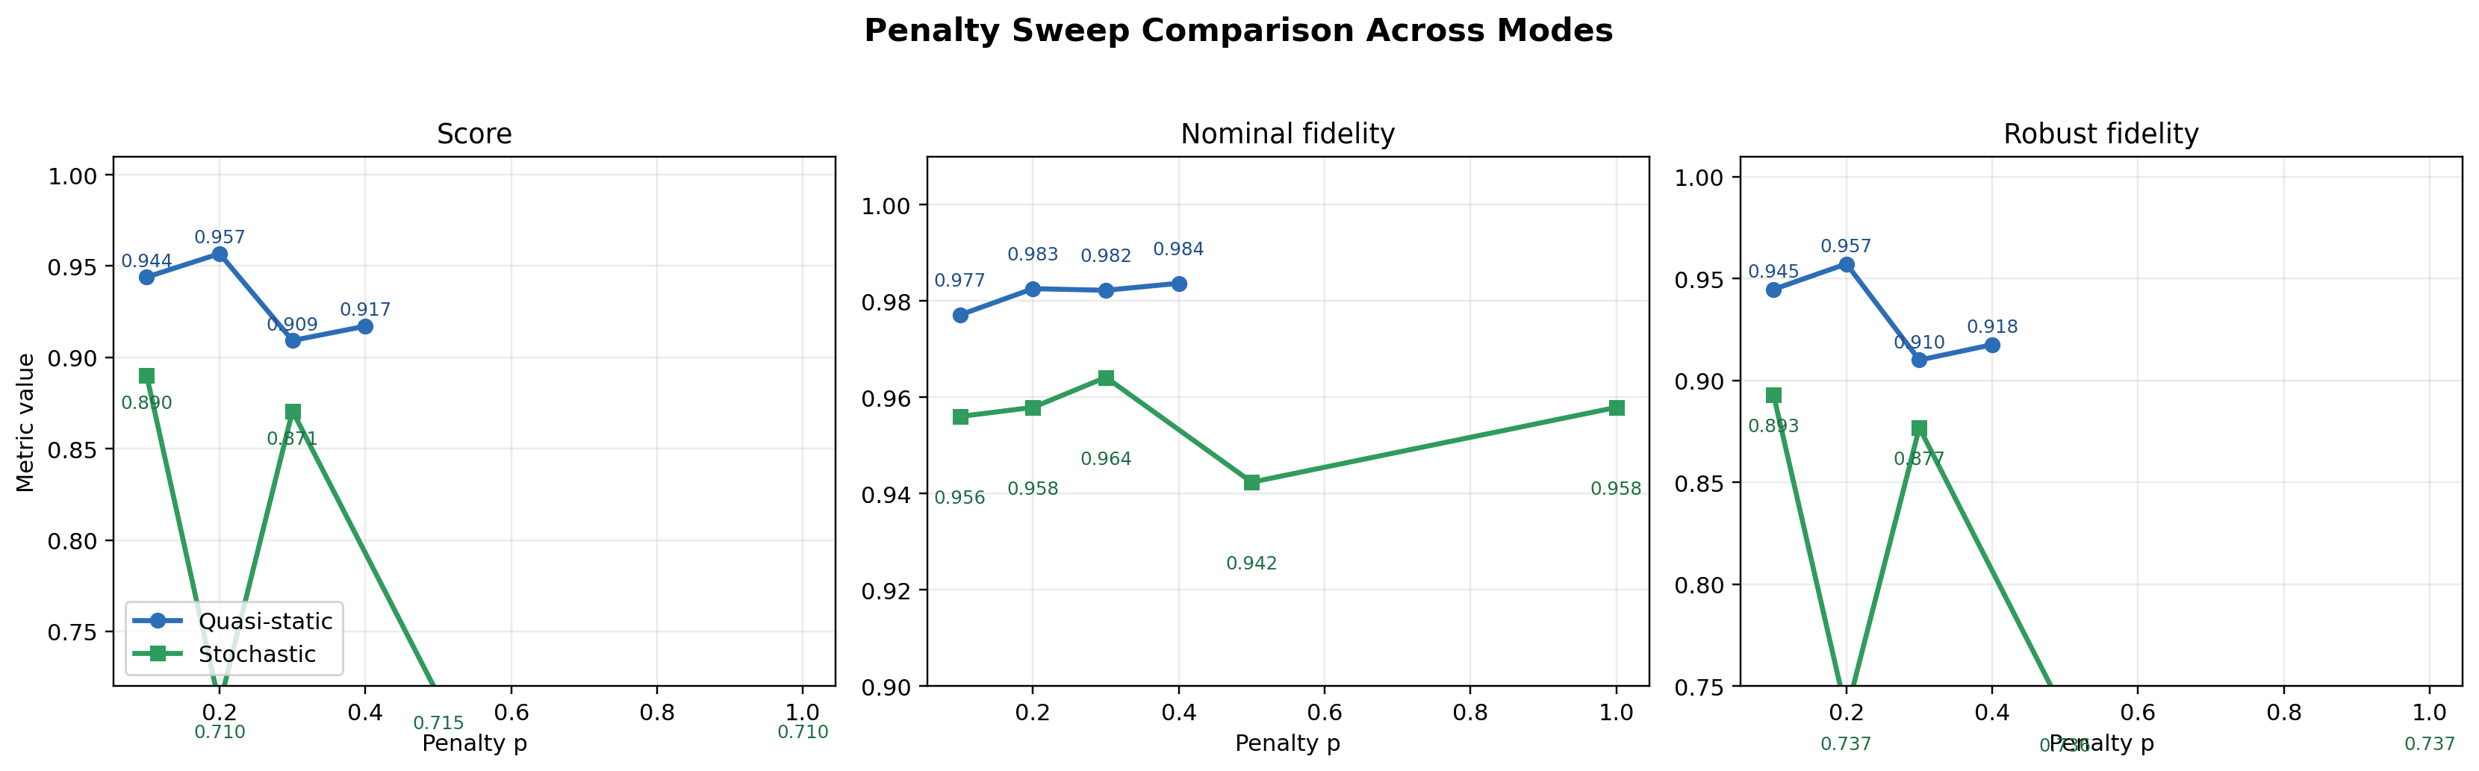
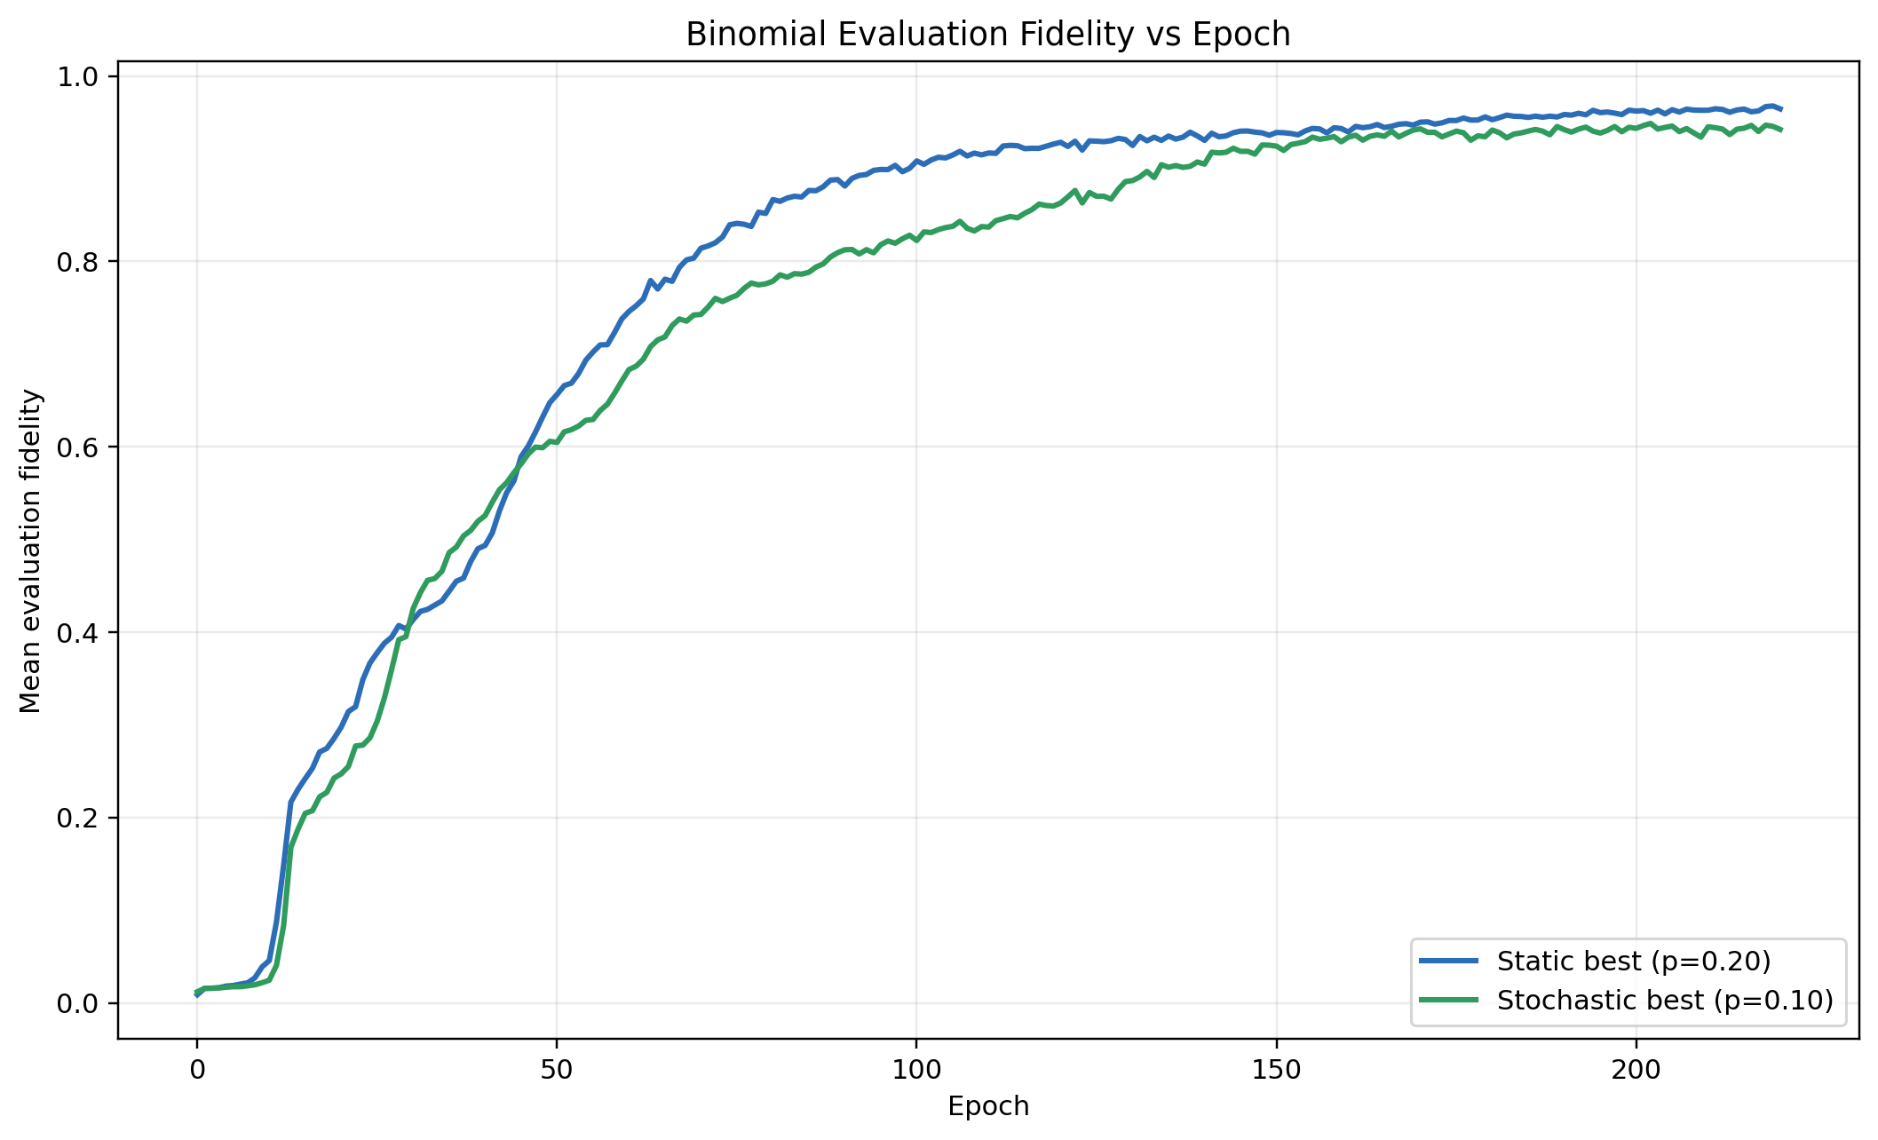
Penalty Sweep Comparison Across Modes
This figure aggregates all tested penalty points for both robust-training branches.
Quasi-static and stochastic curves can favor different p regions.
Current best points remain static p=0.20 and stochastic p=0.10.
This is why we do coarse-to-fine sweeps instead of choosing one p value a priori.
Inset: epoch-wise evaluation trend for best static vs best stochastic run.
All tested p points in static and stochastic branches
24

Slide 25
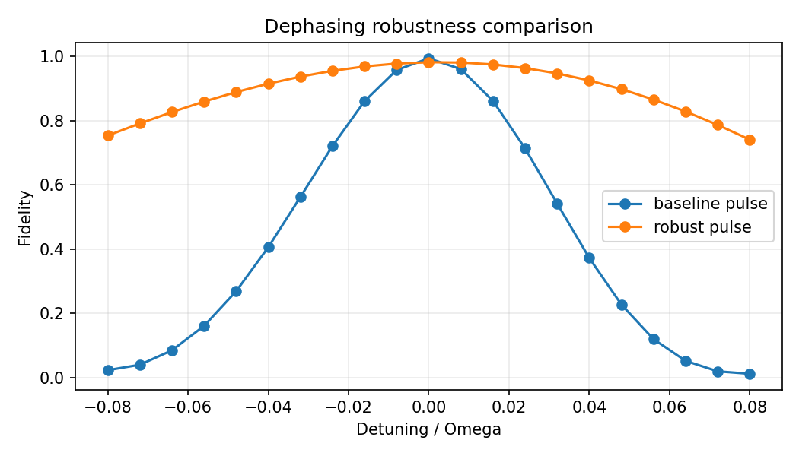
Best Quasi-Static Run (p=0.20)
Score: 0.956800
Nominal fidelity: 0.982545
Robust fidelity: 0.957291
Mean gain vs baseline: 0.467319
Gain at zero detuning: -0.012107
Interpretation: robust improvement is strong across most detuning range, with slight nominal tradeoff.
Current static best run remains the strongest robust candidate in this project snapshot.
Dephasing robustness comparison against baseline
25

Slide 26
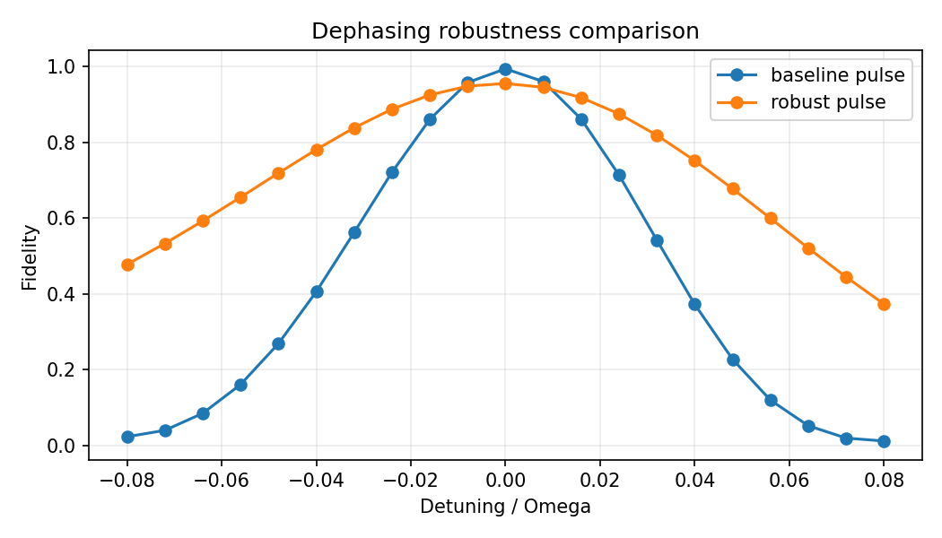
Best Stochastic Run (p=0.10)
Score: 0.890209
Nominal fidelity: 0.956010
Robust fidelity: 0.893108
Mean gain vs baseline: 0.299136
Gain at zero detuning: -0.038642
Interpretation: robust behavior is improved, but current setting still leaves room to reduce zero-noise gap.
Stochastic robust training is promising and provides a clear direction for targeted follow-up runs.
Stochastic robust branch summary
26

Slide 27
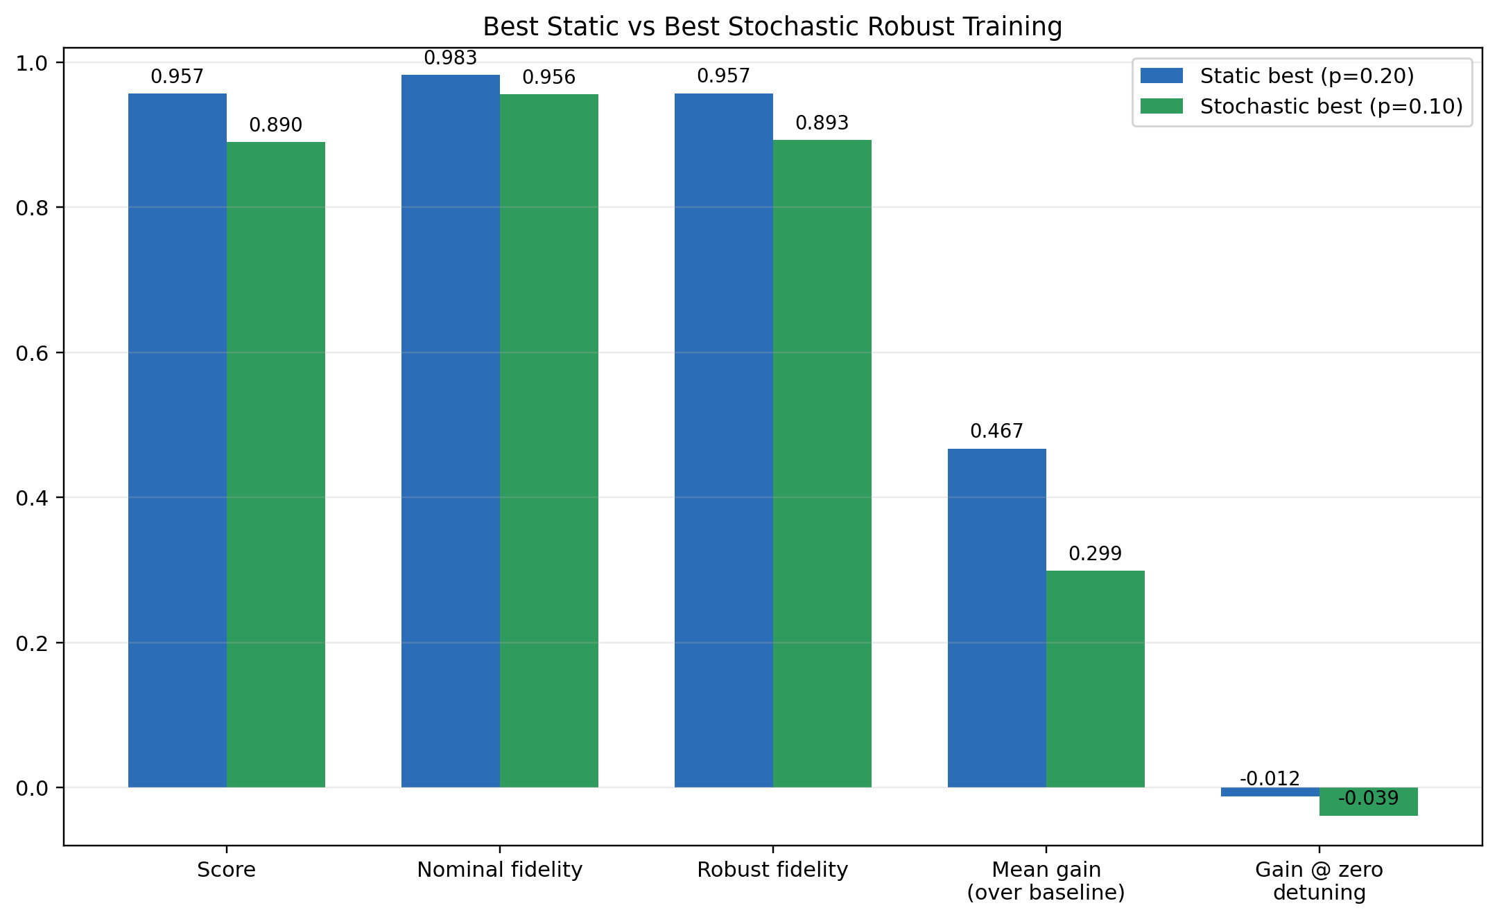
Static vs Stochastic: Current Best Comparison
Static best currently has higher robust average and better overall score.
Stochastic best remains valuable because it matches the intended random-noise training formulation.
Difference does not mean stochastic is wrong; it indicates more tuning/compute may be needed.
This comparison guides the next experimental schedule.
Comparison highlights where stochastic training still needs improvement (especially near zero detuning).
Best-run metric comparison
27

Slide 28
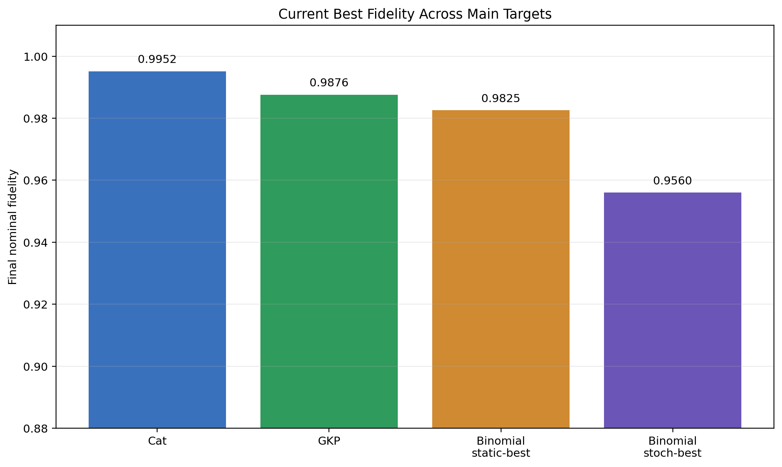
Across Main Targets: Fidelity Snapshot
Cat and GKP already reach high nominal fidelity; binomial robustness is the main active optimization front.
Cat and GKP are high-fidelity nominal targets; binomial is the primary robust-training benchmark.
Cat/GKP and binomial robust candidates
28

Slide 29
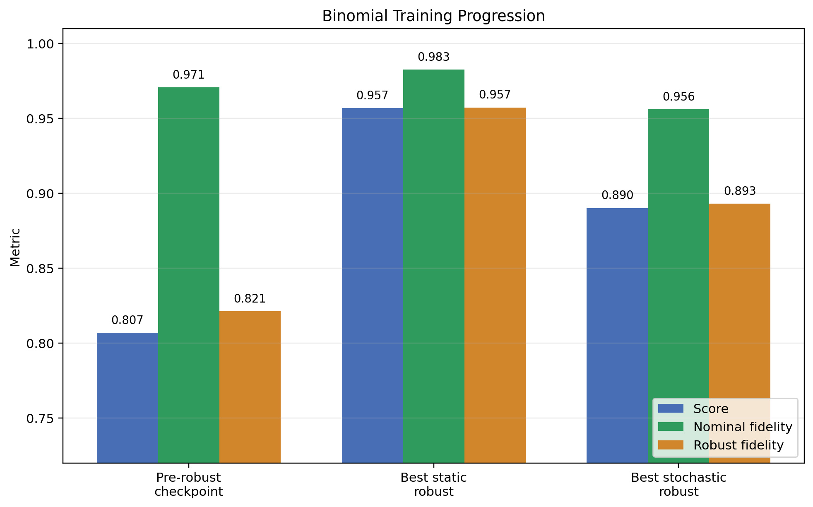
What We Learned So Far
Model-free RL can produce high-quality control pulses for multiple bosonic targets.
Characteristic-function reward plus staged point sampling is practical and interpretable.
Policy-update count and state-specific training budget strongly influence convergence quality.
Quasi-static robust branch currently outperforms stochastic branch on average robust metrics.
Stochastic branch is still meaningful and likely benefits from further targeted hyperparameter tuning.
Current conclusions
29

Slide 30
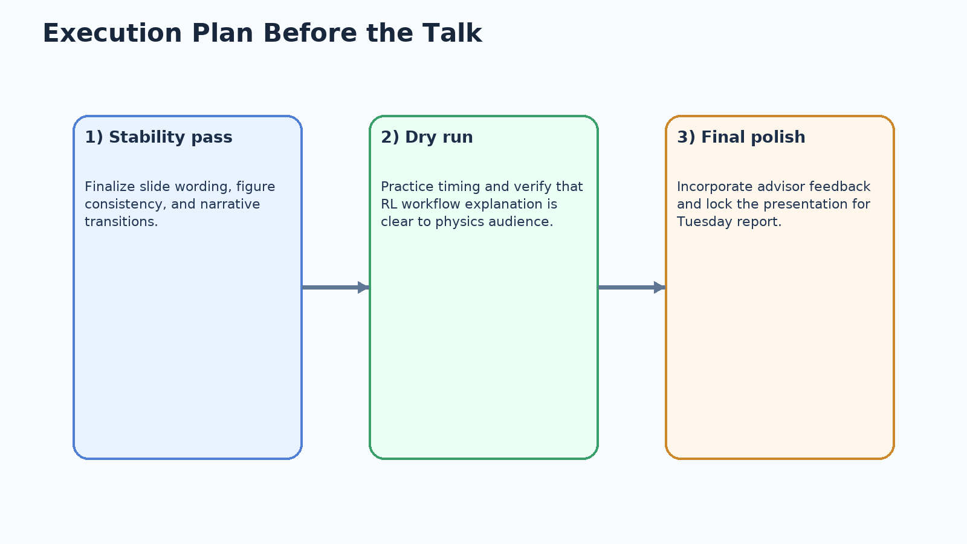
Immediate Next Steps
Refine stochastic branch near p≈0.1 with controlled extra compute budget.
Tune duration-related penalties to reduce zero-detuning nominal gap.
Continue improving GKP with targeted long-horizon training settings.
Prepare final speaking script with concept-first explanation and image-led storytelling.
Keep citations tied to discussed content (Sivak PRX, Matsos PRL, related trapped-ion work).
Outlook
30

Slide 31
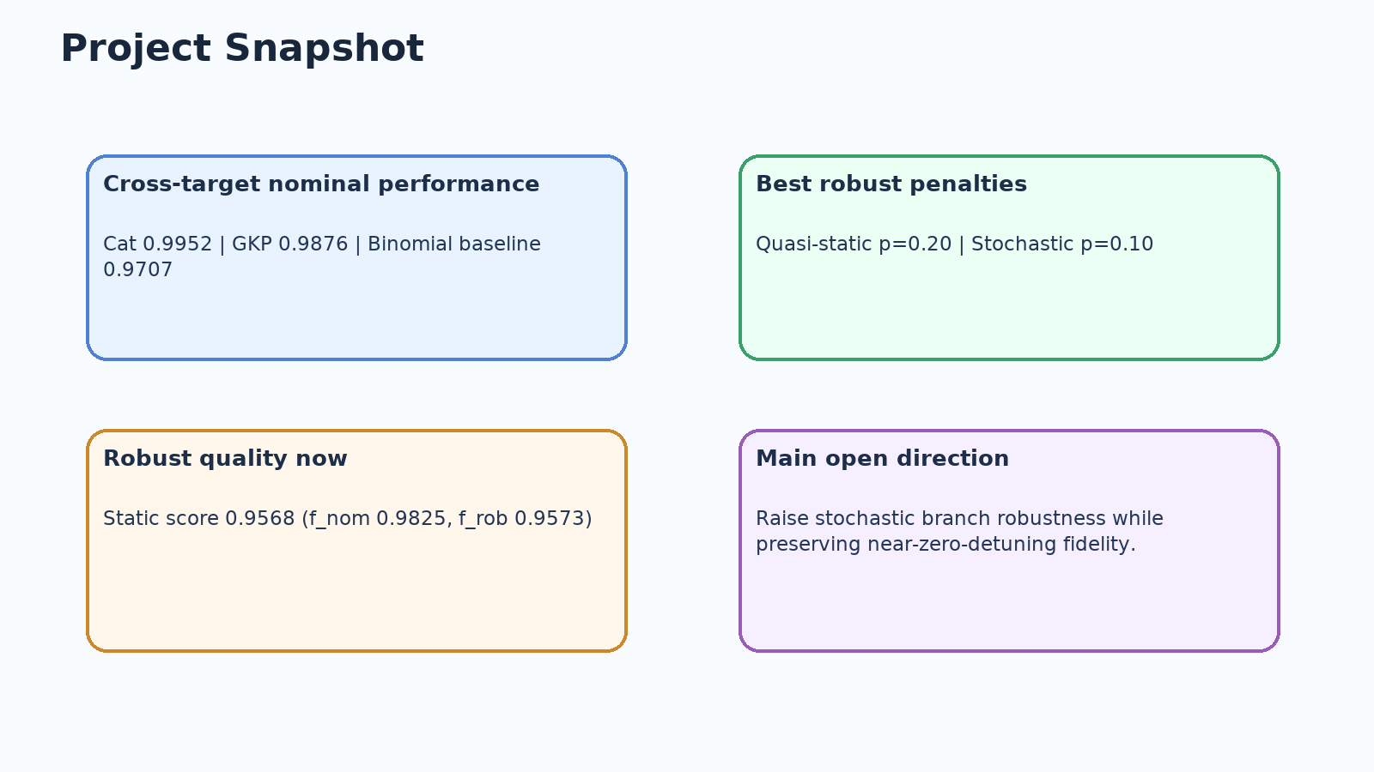
Conclusion
This project demonstrates a clear and explainable RL control workflow for bosonic state preparation.
The method works across Cat/GKP/Binomial targets and supports robust-training extensions.
Current robust best points: quasi-static p=0.20, stochastic p=0.10.
The report now presents a complete story: motivation -> method -> results -> outlook.
Summary
31

Slide 32
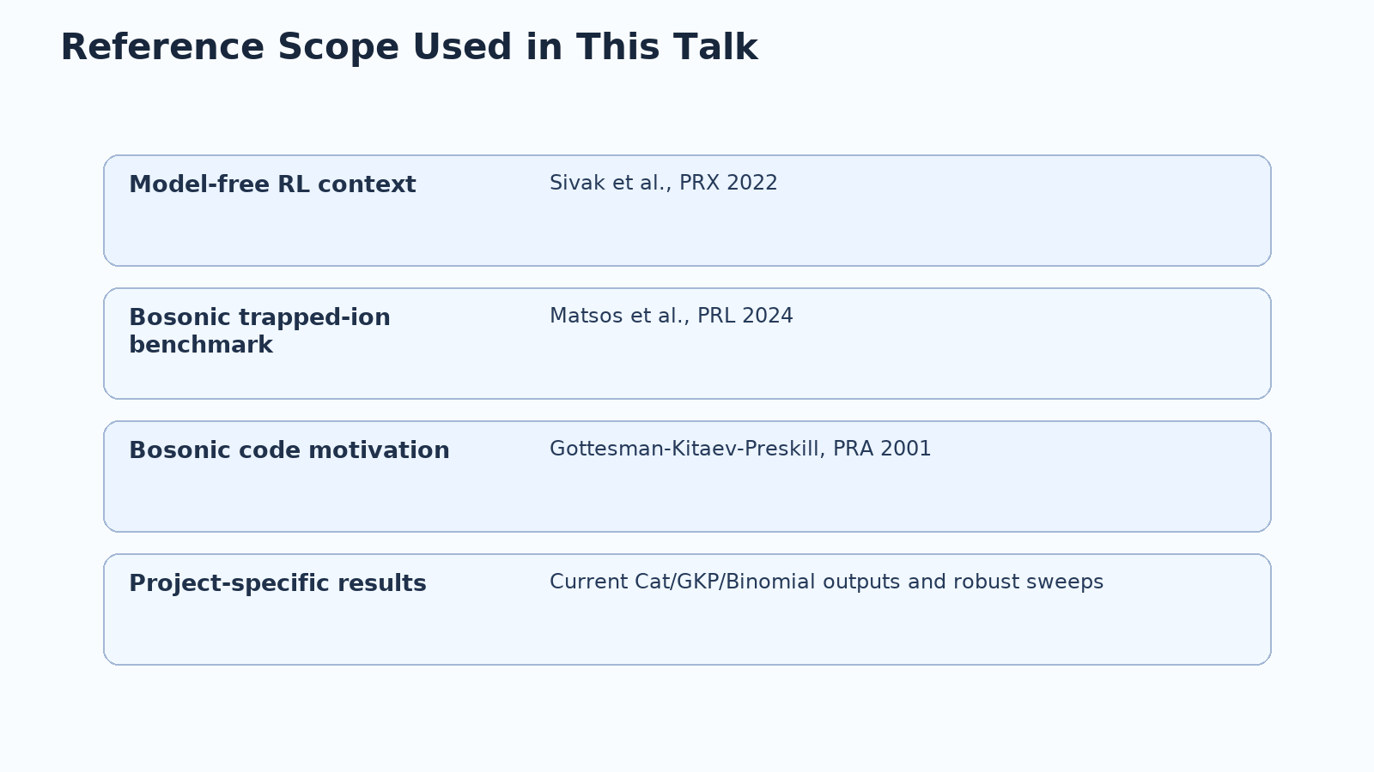
References
D. Gottesman, A. Kitaev, J. Preskill, Phys. Rev. A 64, 012310 (2001).
V. V. Sivak et al., Model-Free Quantum Control with Reinforcement Learning, Phys. Rev. X 12, 011059 (2022).
V. G. Matsos et al., Robust and Deterministic Preparation of Bosonic Logical States in a Trapped Ion, Phys. Rev. Lett. 133, 050602 (2024).
Internal trapped-ion RL project outputs and dephasing-robust sweep logs (2026).
Sydney Nano / Quantum Control Lab discussions and meeting guidance.
Only references cited in talk
32

Slide 33
Appendix: Presentation Flow Checklist
Define episode, epoch, and policy update before showing any result plots.
When showing GIFs, explain that point concentration indicates increased sampling focus.
For robust sweeps, report score, nominal fidelity, robust fidelity, and zero-detuning behavior.
Separate method validity from current performance limits when discussing stochastic results.
Finish with one clear impact statement and immediate follow-up plan.
Suggested transition cues:
Motivation -> 'what problem is worth solving and why now?'
Method -> 'how the RL loop changes pulse parameters over epochs'
Results -> 'what the plots/GIFs prove and what remains open'
Outlook -> 'specific next runs and expected impact'
Appendix
33

